Slide 1
The View from NSF
Margaret Cavanaugh
Deputy Assistant Director for Geosciences
October 4, 2011

Slide 2
NSF’s Mission to Support Fundamental Research
NSF's goals--discovery, learning, research infrastructure and stewardship--provide an integrated strategy to advance the frontiers of knowledge, cultivate a world-class, broadly inclusive science and engineering workforce and expand the scientific literacy of all citizens, build the nation's research capability through investments in advanced instrumentation and facilities, and support excellence in science and engineering research and education through a capable and responsive organization.

Slide 3
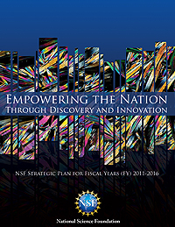
NSF’s Strategic Plan 2011-2016
Vision
NSF envisions a nation that capitalizes on new concepts in science and engineering and provides global leadership in advancing research and education.
NSF Core Values
Visionary
Dedicated to Excellence
Learning and Growing
Broadly Inclusive
Accountable

Slide 4
NSF’s Strategic GOALS
Transform the Frontiers: Emphasizes the seamless integration of research and education as well as the close coupling of research infrastructure and discovery.
Innovate for Society: Points to the tight linkage between NSF programs and societal needs, and highlights the role that new knowledge and creativity play in economic prosperity and society’s general welfare.
Perform as a Model Organization: Emphasizes importance to NSF to attain excellence and inclusion in all operational aspects.

Slide 5
Towards a Sustainable Human Future
Whether it’s improving our health or harnessing clean energy, protecting our security or succeeding in the global economy, our future depends on reaffirming America’s role as the world’s engine of scientific discovery and technological innovation.
- President Barack Obama
Of all the challenges we face as a nation and as a planet, none is as pressing as the three-pronged challenge of climate change, sustainable development and the need to foster new and cleaner sources of energy.
-Office of Science and Technology Policy, Executive Office of the President

Slide 6
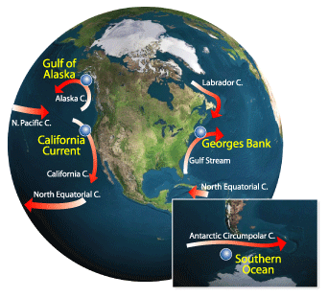
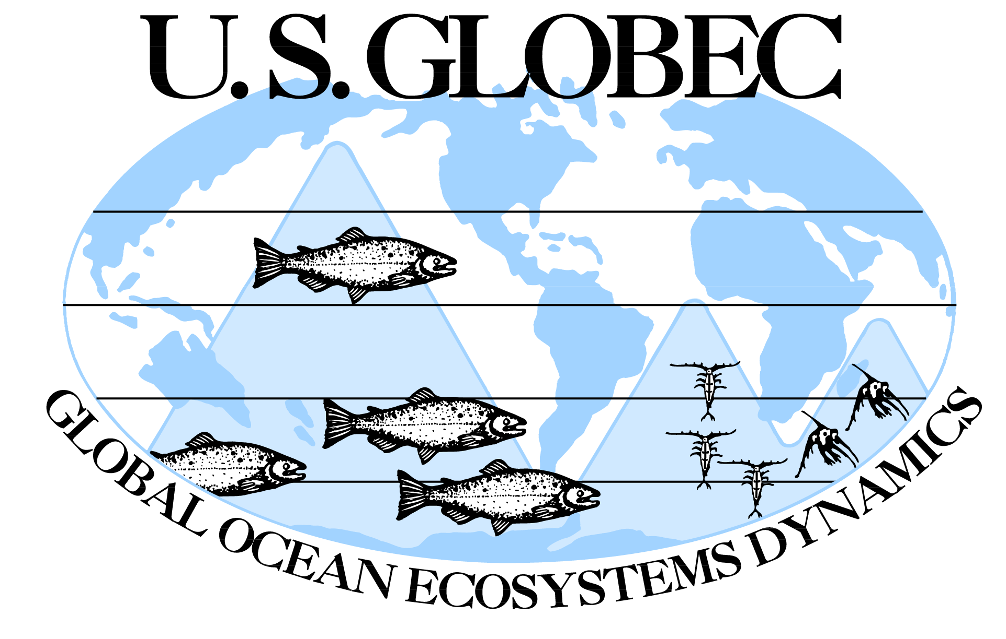
The principal objective of U.S. GLOBEC
research is to understand and predict the
effects of global climate change on ocean
ecosystem dynamics.

Slide 7
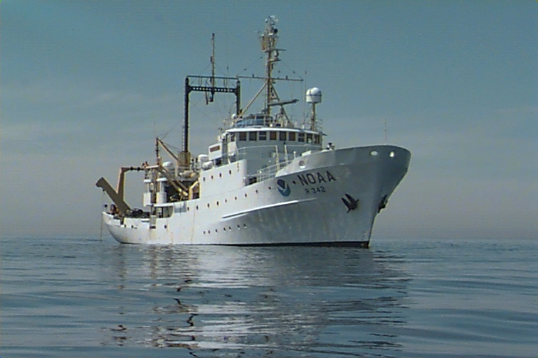
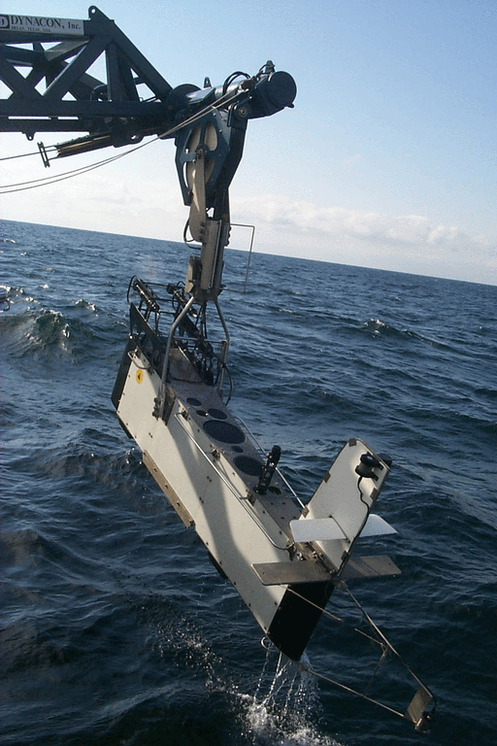
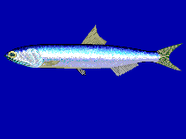
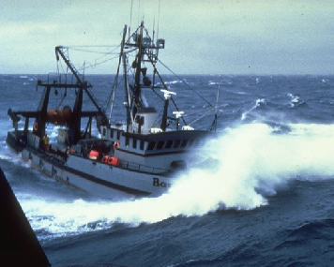
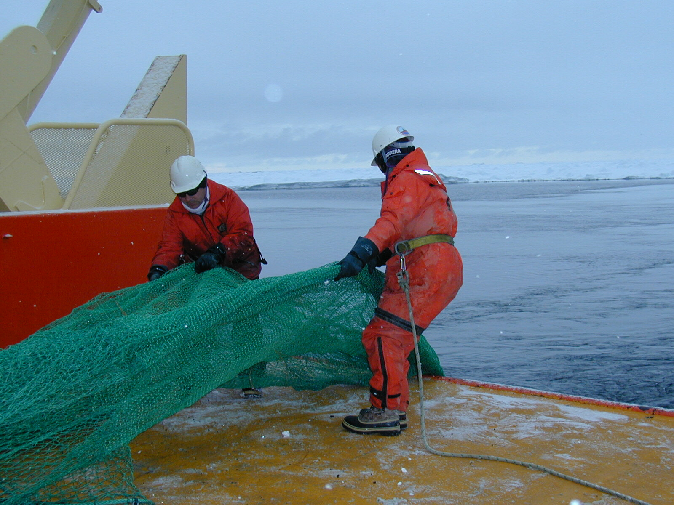
Marine fisheries support $40 billion per year industries in the United States. Understanding the interactive effects of environmental change and human impacts through harvesting is essential in devising sustainable exploitation strategies.

Slide 8
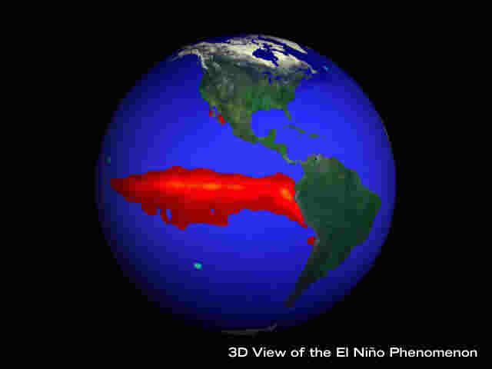
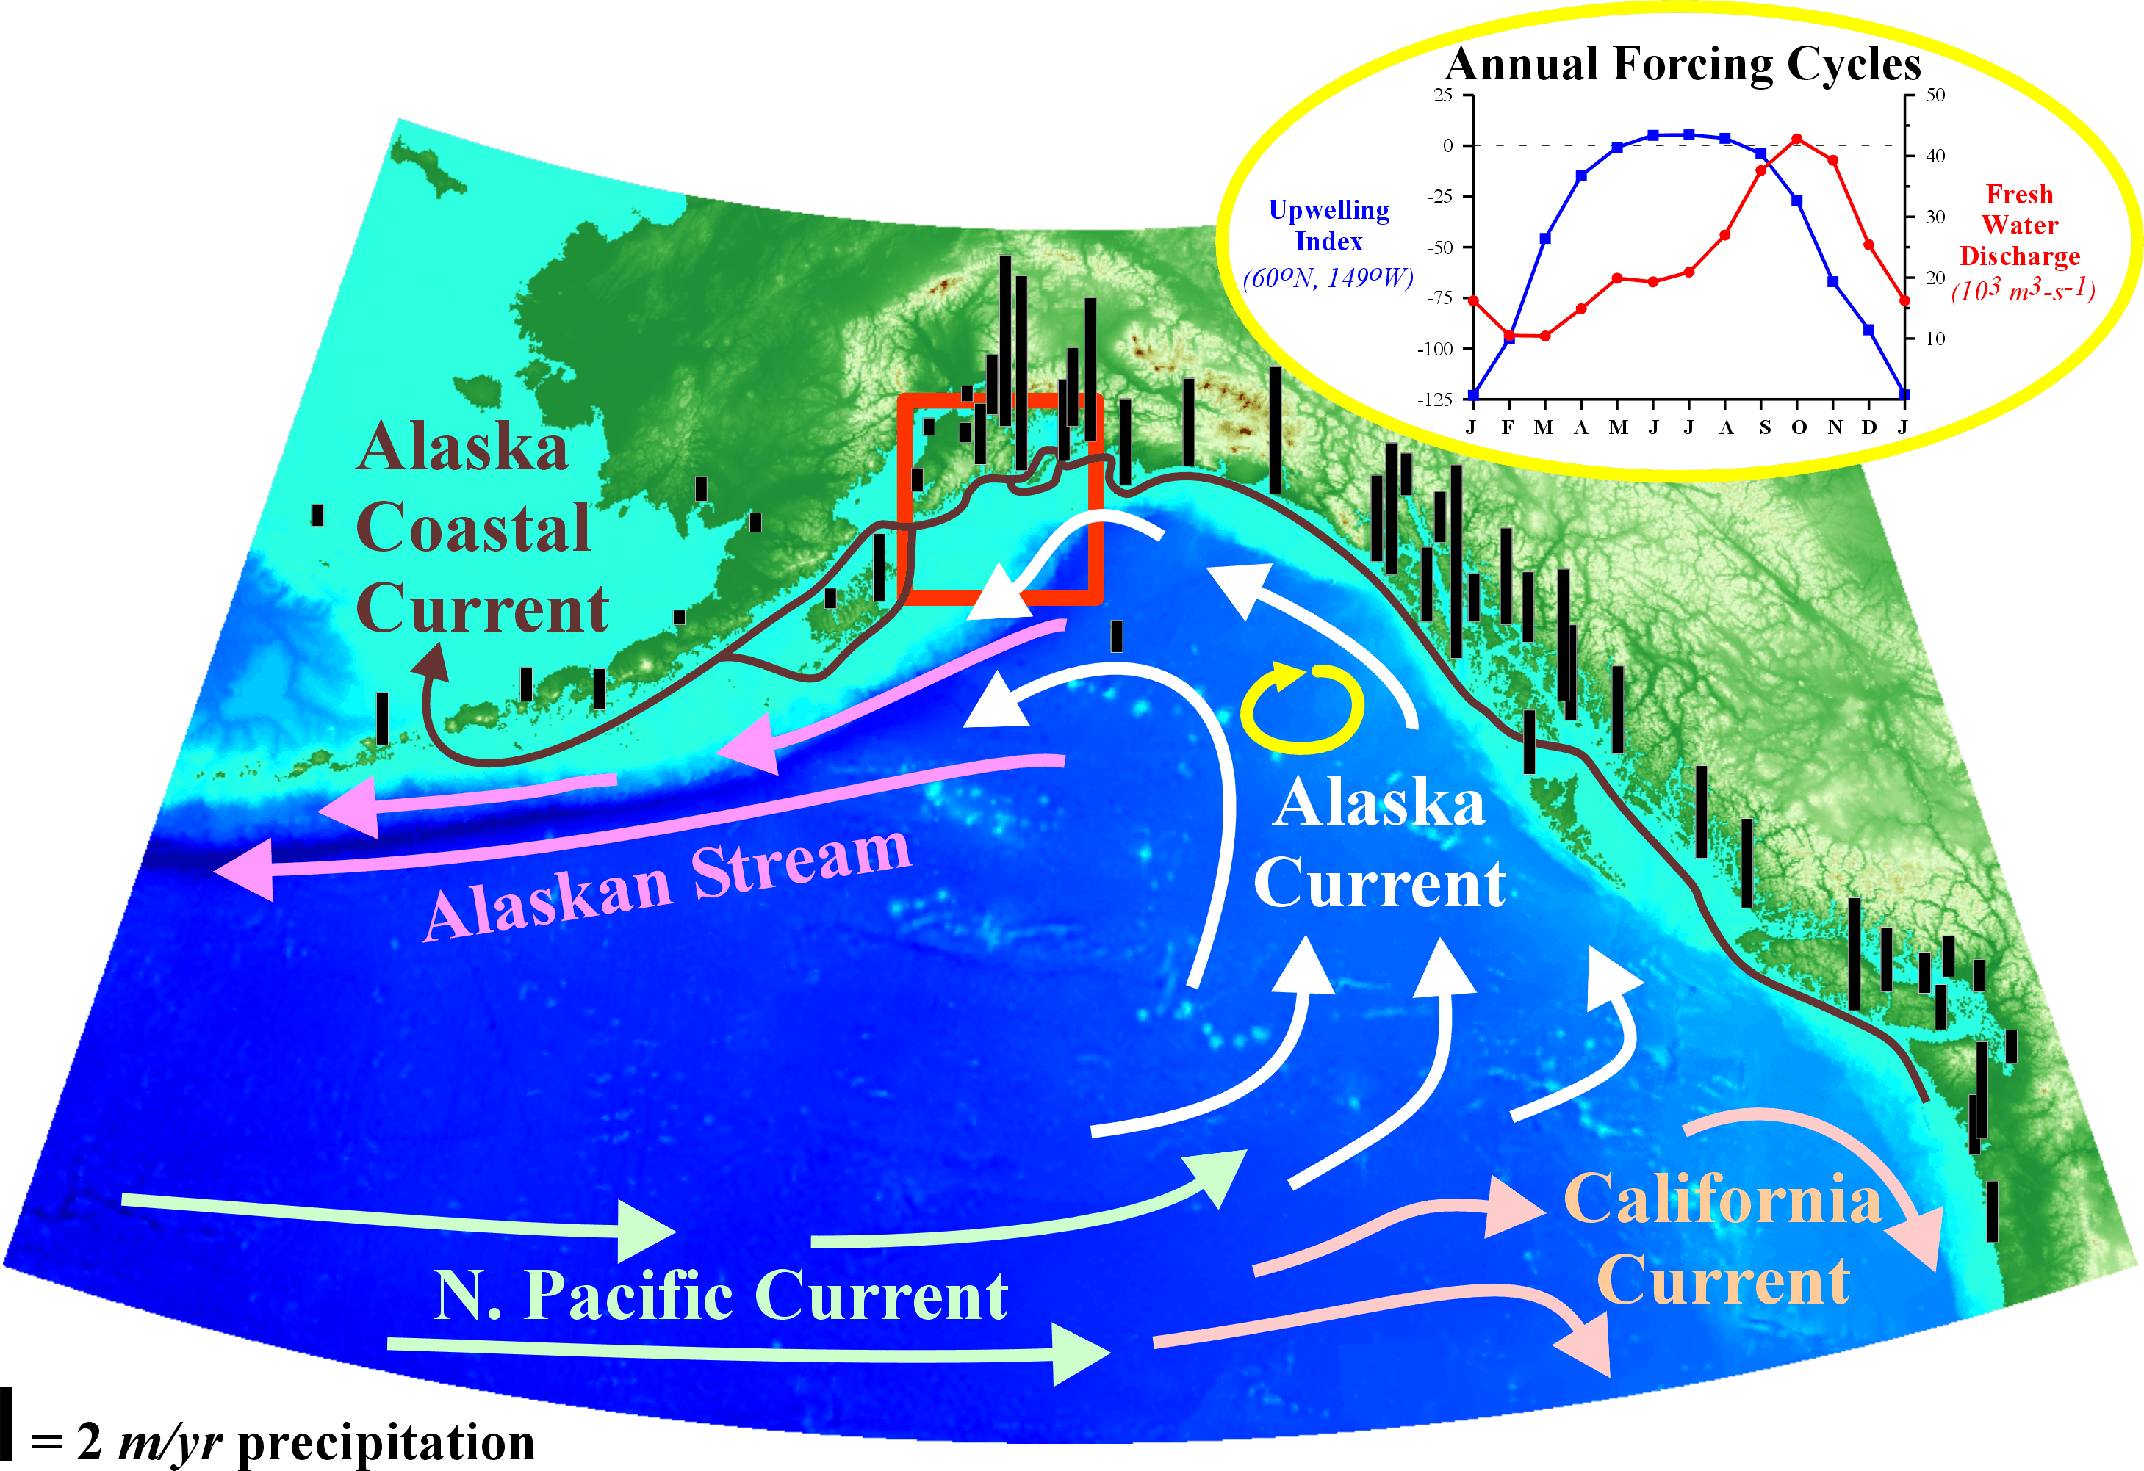
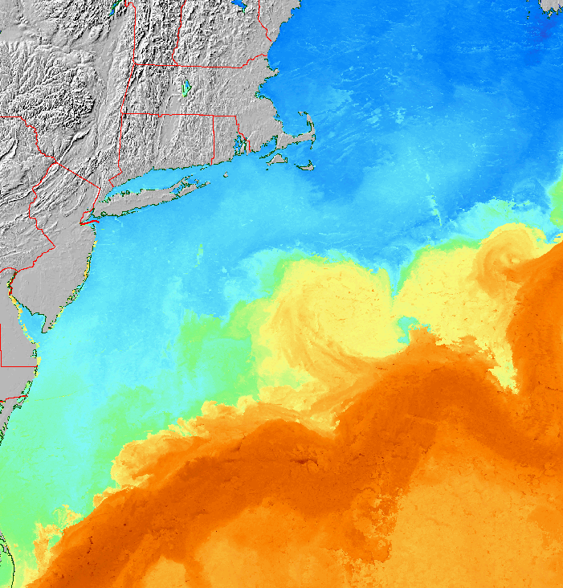
Support of GLOBEC
Long-term investment—In the past 20 years, NSF, NOAA and its labs, and academic partners have invested roughly $200 million in GLOBEC research
Support of interdisciplinary research approaches to target complex problems
Research has yielded significant contributions to fisheries resource management
Notes:
$200 million INCLUDES SHIP COSTS.

Slide 9
Example of GLOBEC Science
Ecosystems along the continental shelf waters of the Northwest Atlantic Ocean experiencing large, rapid changes due to overfishing as well as climate forcing.
Charles Greene, Cornell, Andrew Pershing, U-Maine (Science, 2007)
The influx of fresh water from Arctic climate change is impacting seasonal fisheries and plankton cycles.
Credit: JupiterImages

Slide 10
Example of GLOBEC and Fisheries Management
Adult Scallops – 1957-1980
Use of particle tracking methods to help inform management of scallops on Georges Bank
Tremblay et al. (1994) Drift of sea scallop larvae Placopecten magellanicus on Georges Bank: A model study of the roles of mean advection, larval behaviour and larval origin. Deep-Sea Research II 41, 7-49. U.S. GLOBEC Contribution #1.

Slide 11
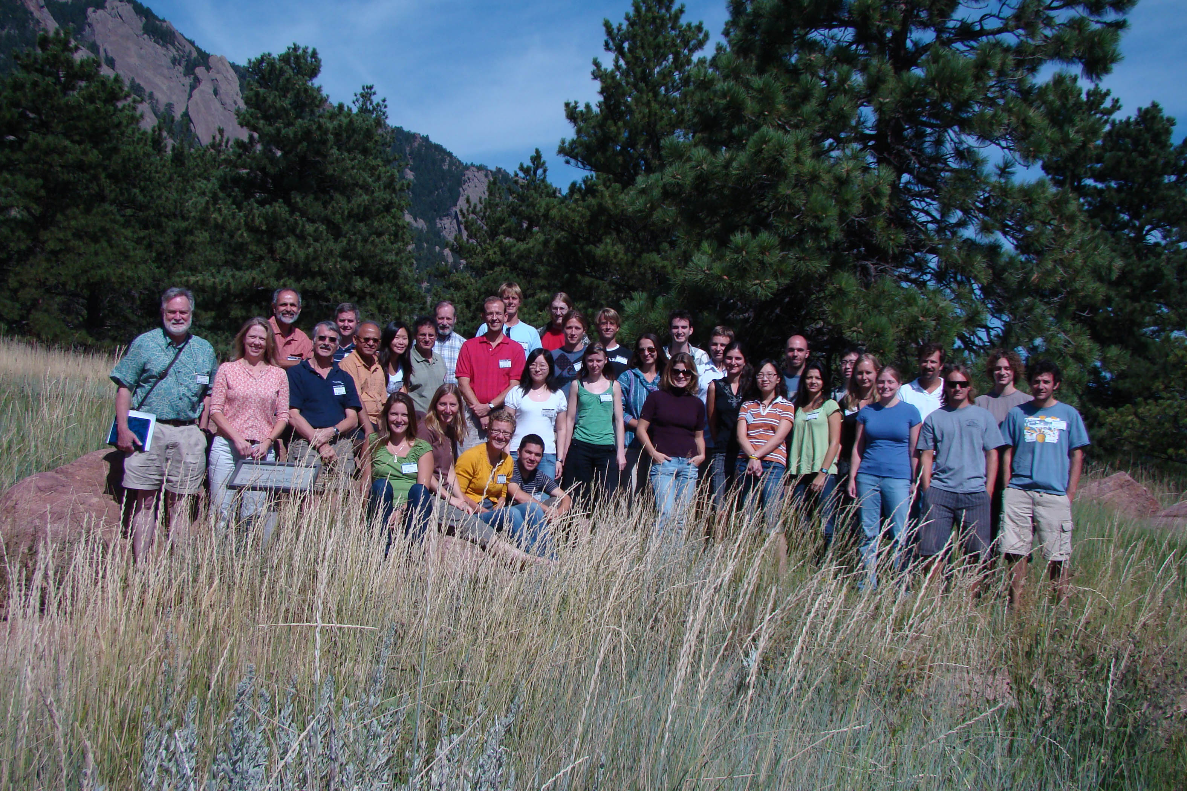
GLOBEC and Training of Future Scientific Leaders
Summer Colloquium 2009 at NCAR
Marine Ecosystems and Climate: Modeling and Analysis of Observed Variability
Targeted at Graduate Students in Climate and Marine Ecosystems

Slide 12
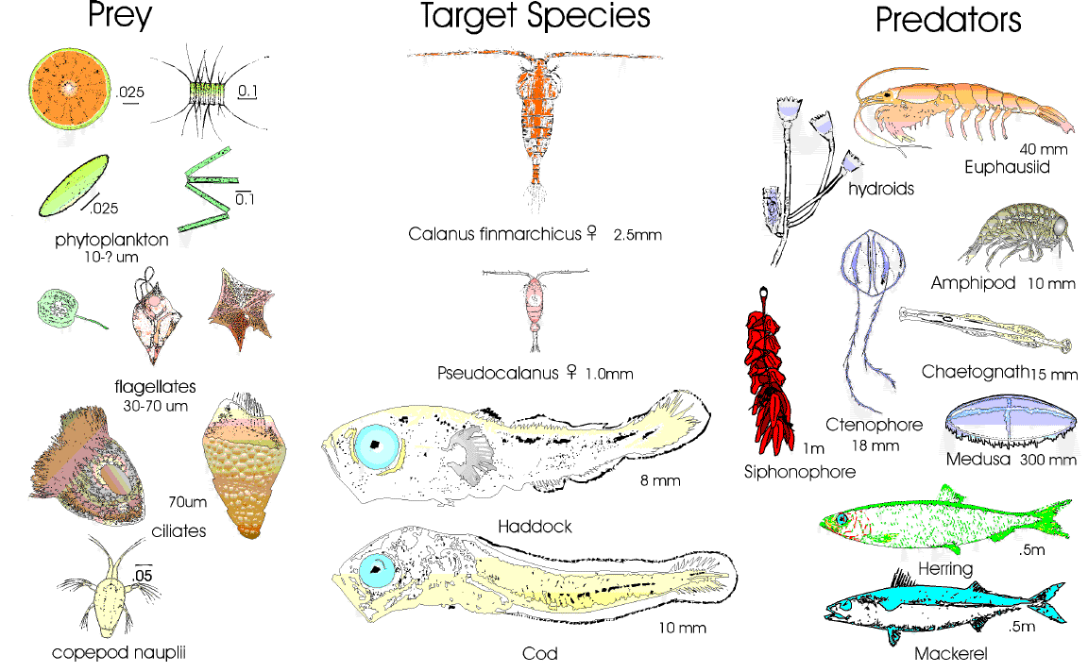
Looking forward
Coordinated interdisciplinary process studies of the scale of GLOBEC are needed to understand ecosystem dynamics on local, regional, and global scales.
Long-term observational networks are essential
Data assimilation to keep models on track
Process studies to understand changing dynamics

Slide 13
NSF and Sustainability Science
GLOBEC’s objective to broadly pursue pressing questions about climate change impacts and sustainability is in concert with NSF’s major investment in Science, Engineering and Education for Sustainability (SEES).

Slide 14
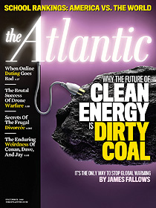
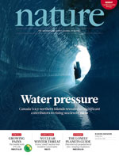
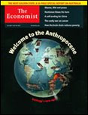
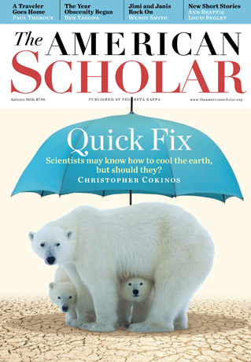
Sustainability Issues Remain at the Forefront

Slide 15
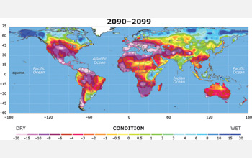
Sustainability Science, Engineering and Education
National Academy of Sciences definition:
“The interactions between natural and social systems and how those interactions affect the challenge of sustainability:
…meeting the needs of present and future generations while substantially reducing poverty and conserving the planet’s life support systems”

Slide 16
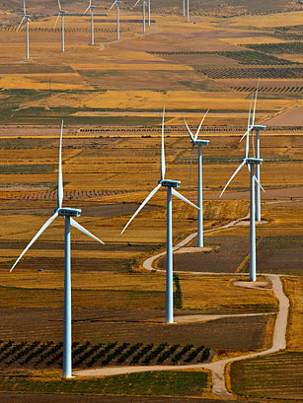
SEES Mission and goals
To advance science, engineering, and education to inform the societal actions needed for environmental and economic sustainability and sustainable human well-being
Goal 1: Support interdisciplinary research and education that can facilitate the move towards global sustainability.
Goal 2: Build linkages among existing projects and partners and add new participants in the sustainability research enterprise.
Goal 3: Develop a workforce trained in the interdisciplinary scholarship needed to understand and address the complex issues of sustainability.

Slide 17
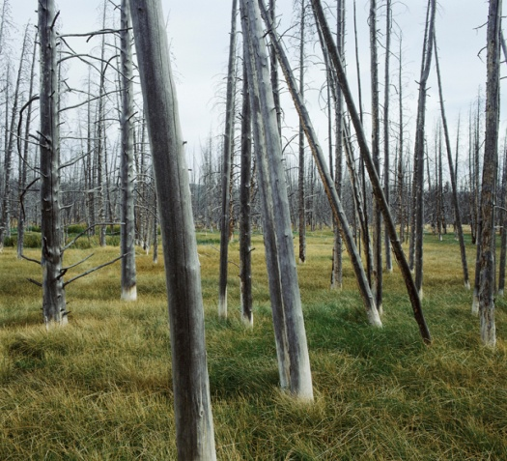
SEES Takes the Long View
Sustainability requires long-term perspective emphasizing:
Integrated approaches across disciplines
Developing systems-level models
Realizing data-enabled science
Linking Observational networks
Exploring linkages between technological solutions and environmental effects
Communicating research findings to decision-makers and the public

Slide 18
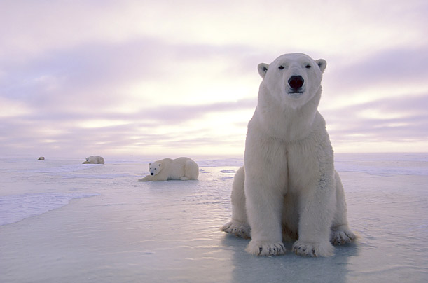
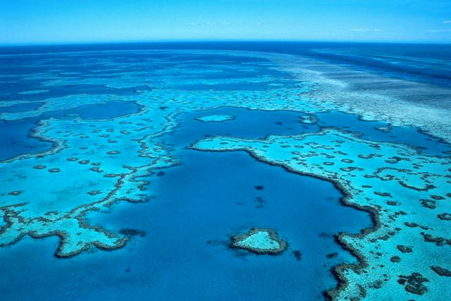
Proposed Future SEES Focus Areas
Chemistry, Materials, Engineering
Renewable, non-toxic materials, process improvements
Coastal and Arctic Regions
Vulnerability, resilience, cultural impacts
Hazards and Disaster
Science, engineering, risk assessment, decision-making
Information Science and Engineering
Data analytics, smart systems, green computing

Slide 19
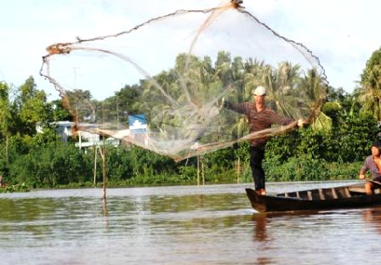
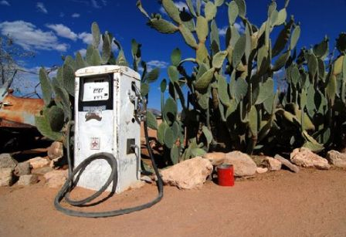
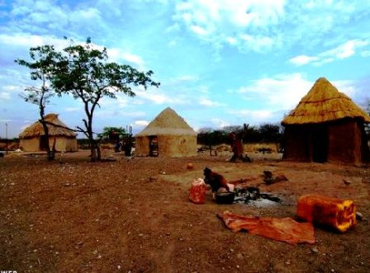
photos: www.dawide.com
The Earth System Sustainability Initiative
Notes:
Question:
A common title page for GA?
what title
No sponsors?
Note that ESSI is a working title.

Slide 20
Need for a unified strategic framework to:
deepen our understanding of the Earth system
deliver solutions to sustainability challenges, at regional to global scale
Notes:
Building upon the foundation provided by the GEC research initiatives and by national, international and intergovernmental investments in global change research, the scientific community must now deliver the knowledge that will enable countries, regions, and economic sectors to embark on transitions to sustainability in order to secure human development in the face of rapid global change.
While deepening our understanding of the Earth System and of human impacts, we must build the capacity to deliver solutions to pressing sustainability challenges at regional to global scales.
We must attract the brightest young scientists, particularly in developing countries, and significantly expand the involvement of social scientists and economists in the Grand Challenge research agenda. We must increasingly adopt research approaches that actively involve stakeholders and decision-makers across governments, business and civil society in the process of defining and carrying out research. And we must effectively deliver end-to-end environmental services.
In June 2010, when ICSU convened a two-day meeting with the GEC leadership of the GEC initiatives and sponsors, funders and other key parties, there were different views concerning the future of global sustainability research. However, one sentiment united the room: business as usual is not an option. The existing global change research arrangements are unable to adequately meet current needs. They do not address the full range of global sustainability research challenges defined in the Grand Challenge paper, particularly with regard to research on policy, institutional and behavioral responses to global change. In addition, they do not adequately address the needs for regional and decadal prediction of global change; or include a sufficient focus on transdisciplinary research as a means to solve real world problems. And, they do not adequately engage younger scientists or take full advantage of the potential of networked organizational arrangements.

Slide 21
Society demands reliable projections of coming changes…

Slide 22
