Slide 1
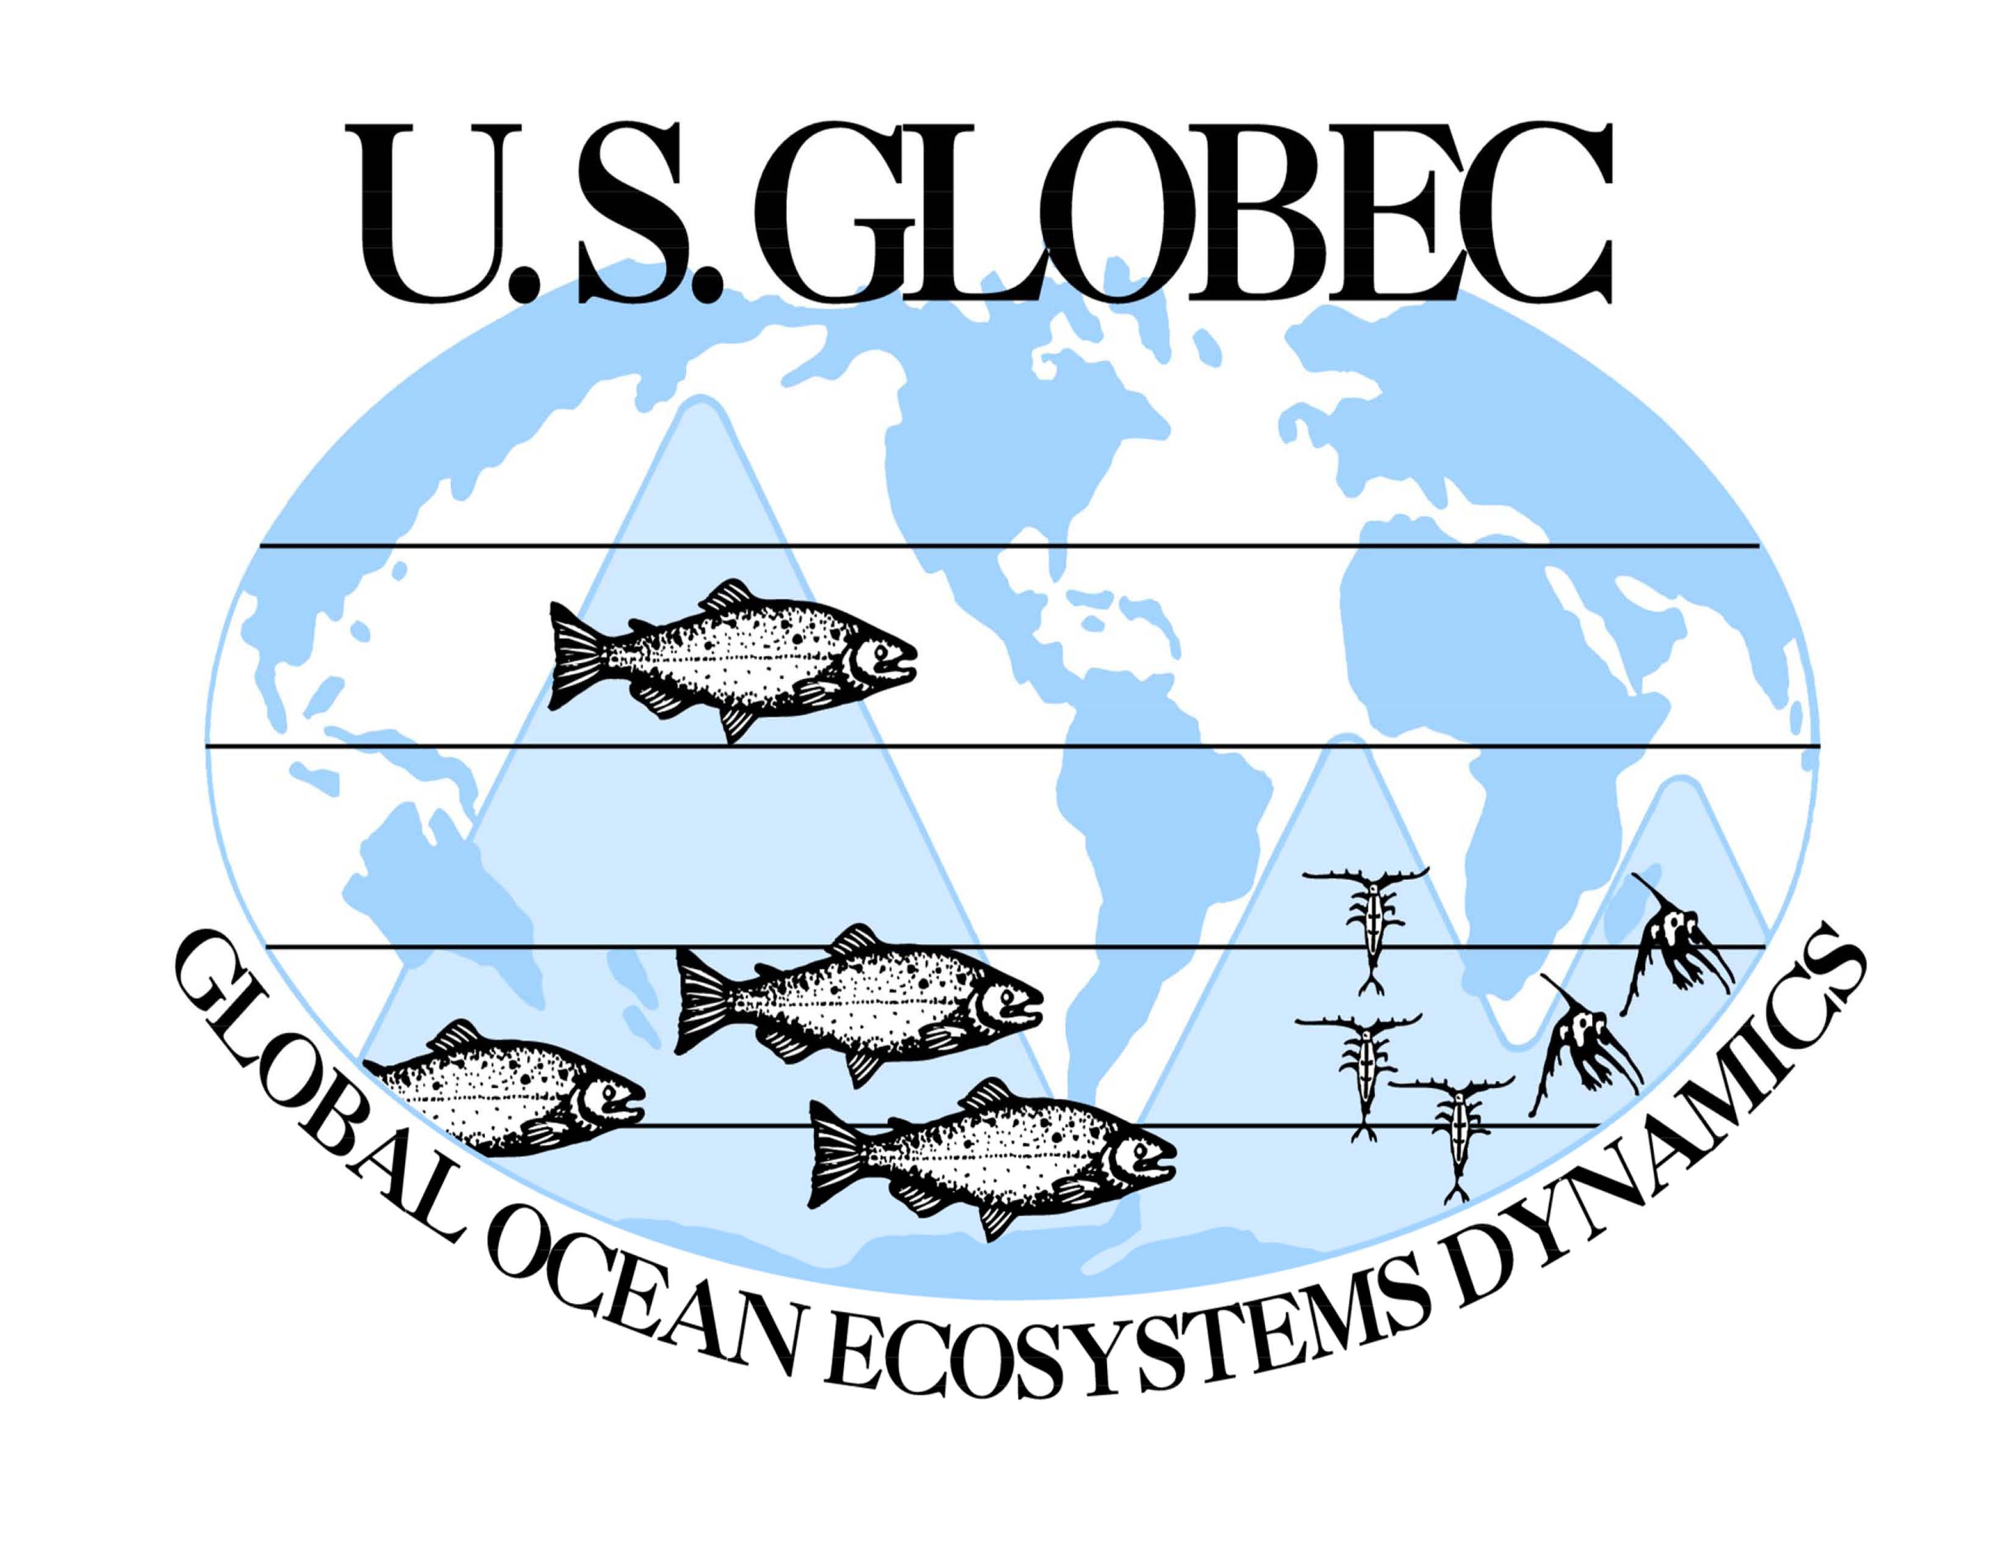
The People of U.S. GLOBEC
Dale B. Haidvogel
Institute of Marine and Coastal Sciences
Rutgers University

Slide 2
A Reminiscence in Pictures
Hundreds of people participated in US GLOBEC as PIs, undergraduate and graduate students, postdoctoral investigators, technicians, program managers, and in many other ways. Here are only a few.
At the Beginning
Toward the end
Along the Way: Three Young Investigators
Baby pictures

Slide 3
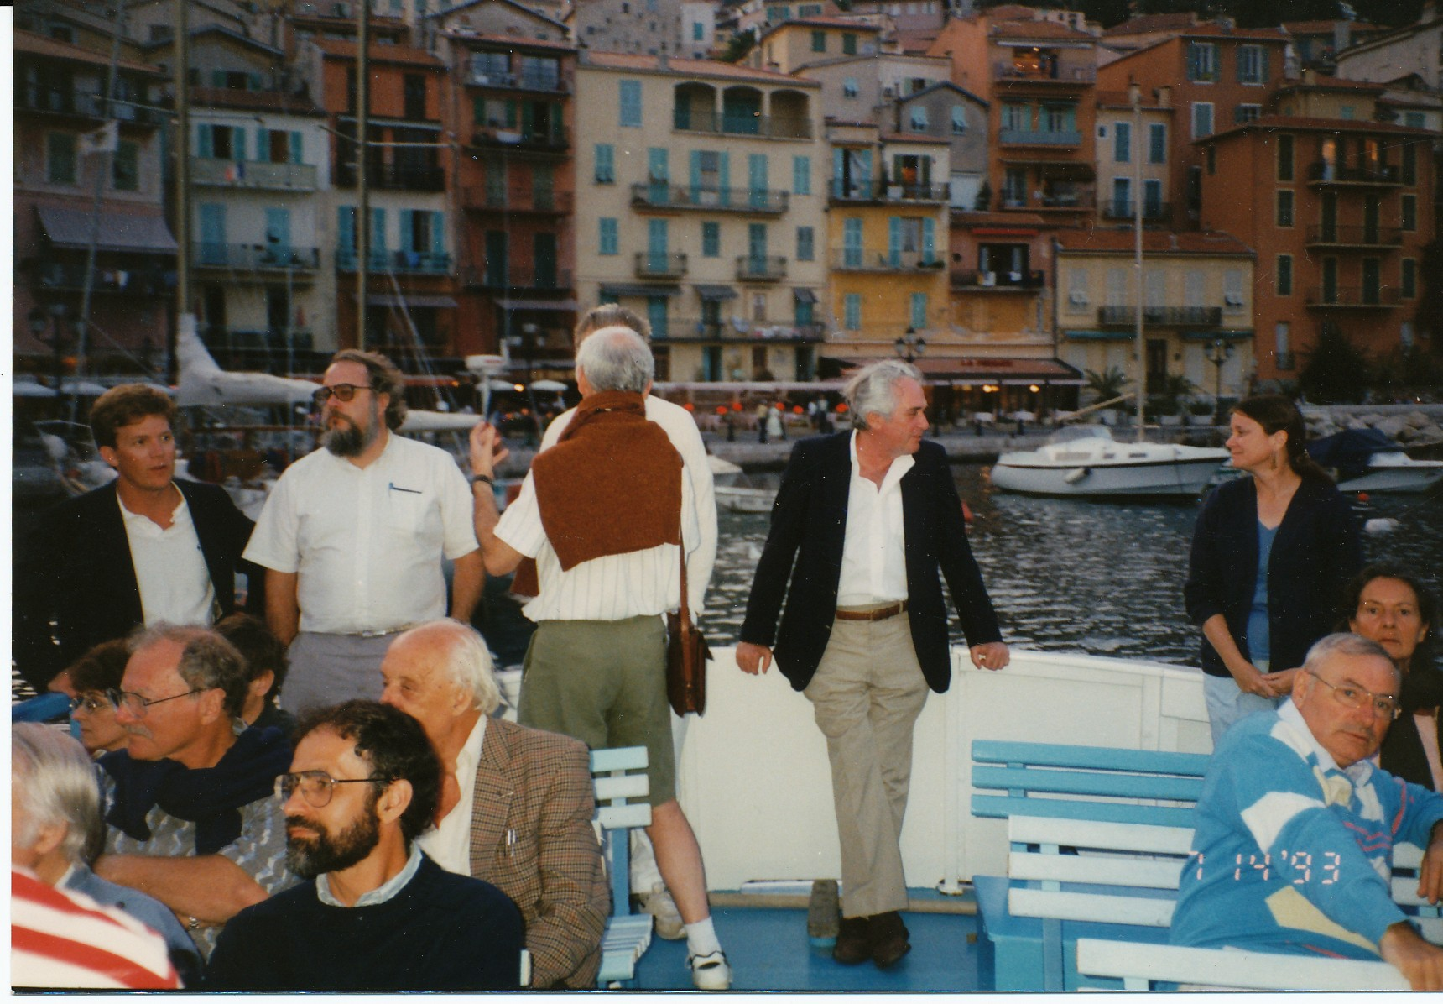
First Meeting of the GLOBEC International Working Group on Modeling
Villefrance sur mer, France
July 1993

Slide 4
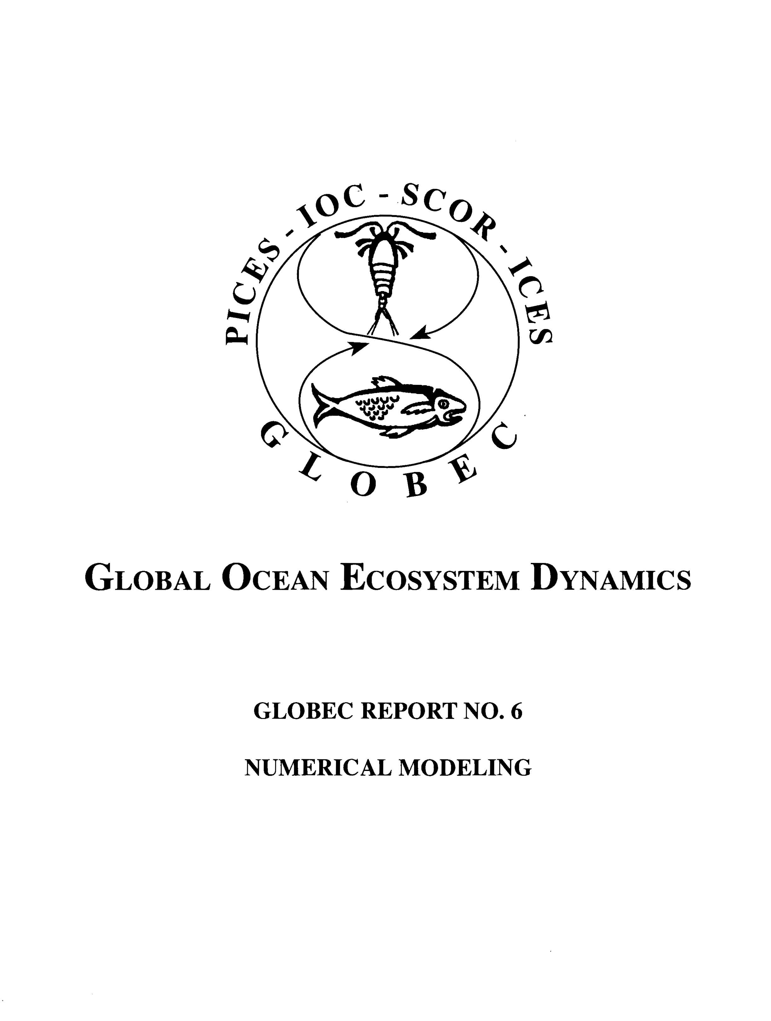
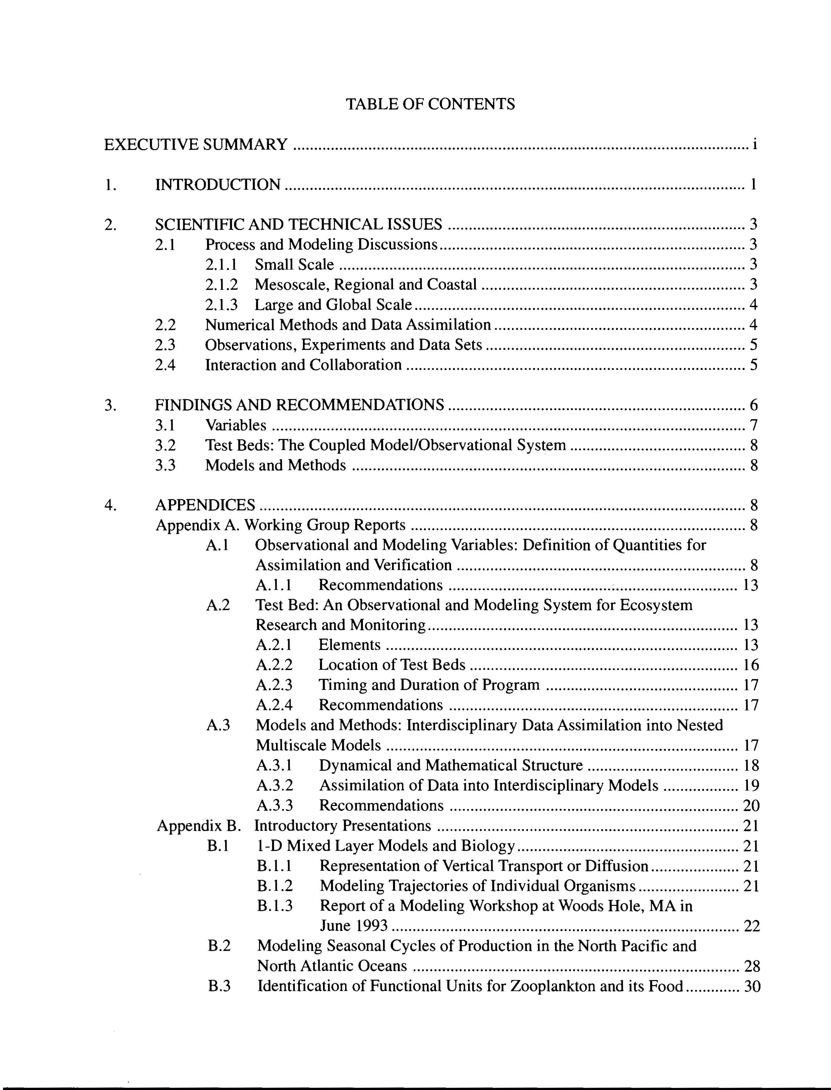
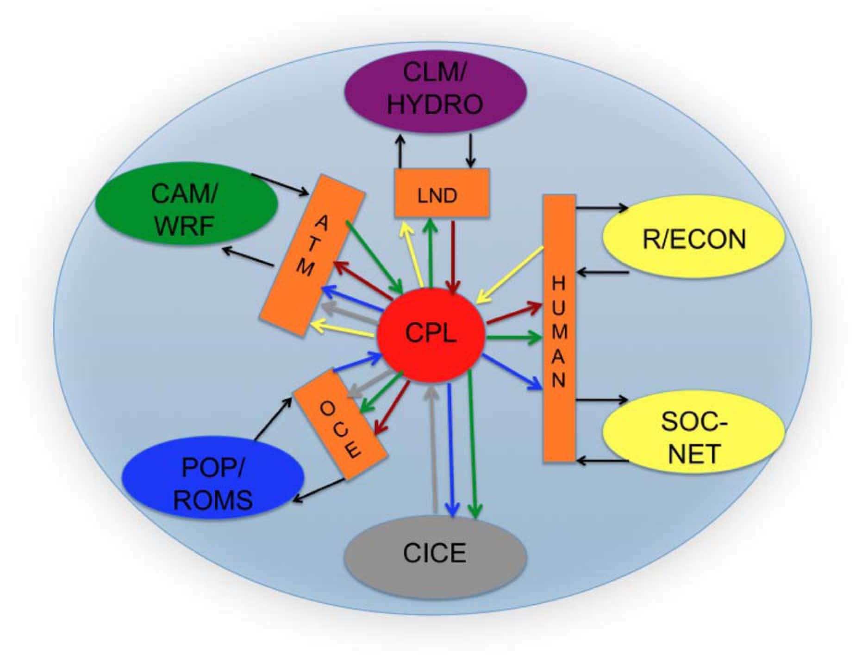
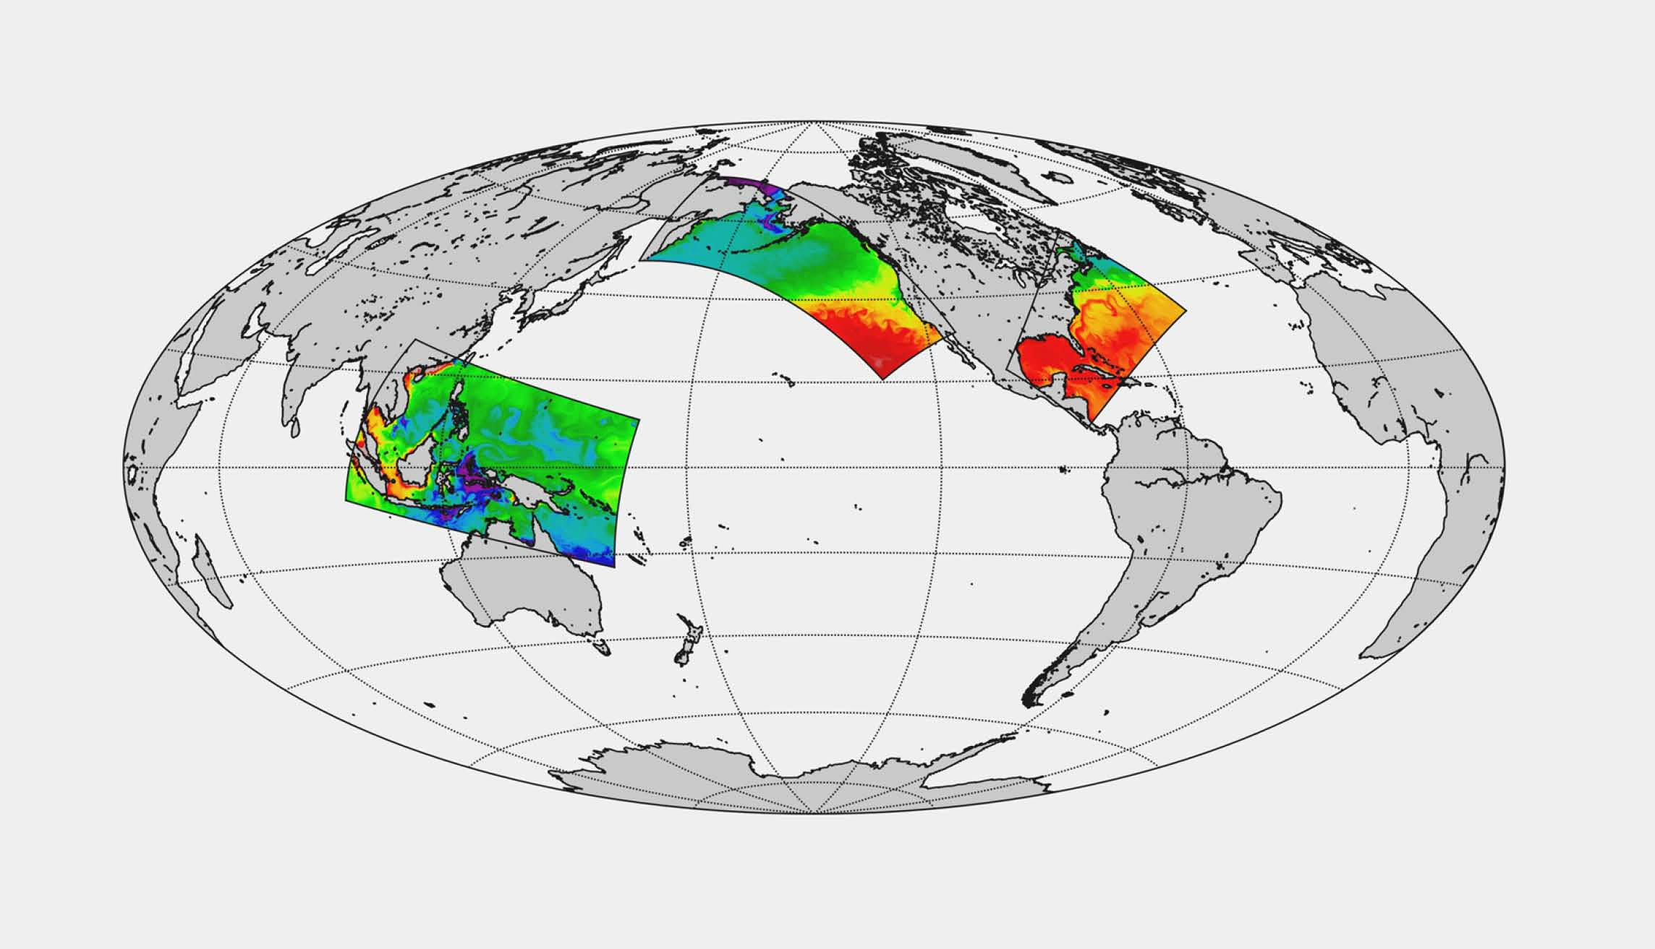
Time Passes …

Slide 5
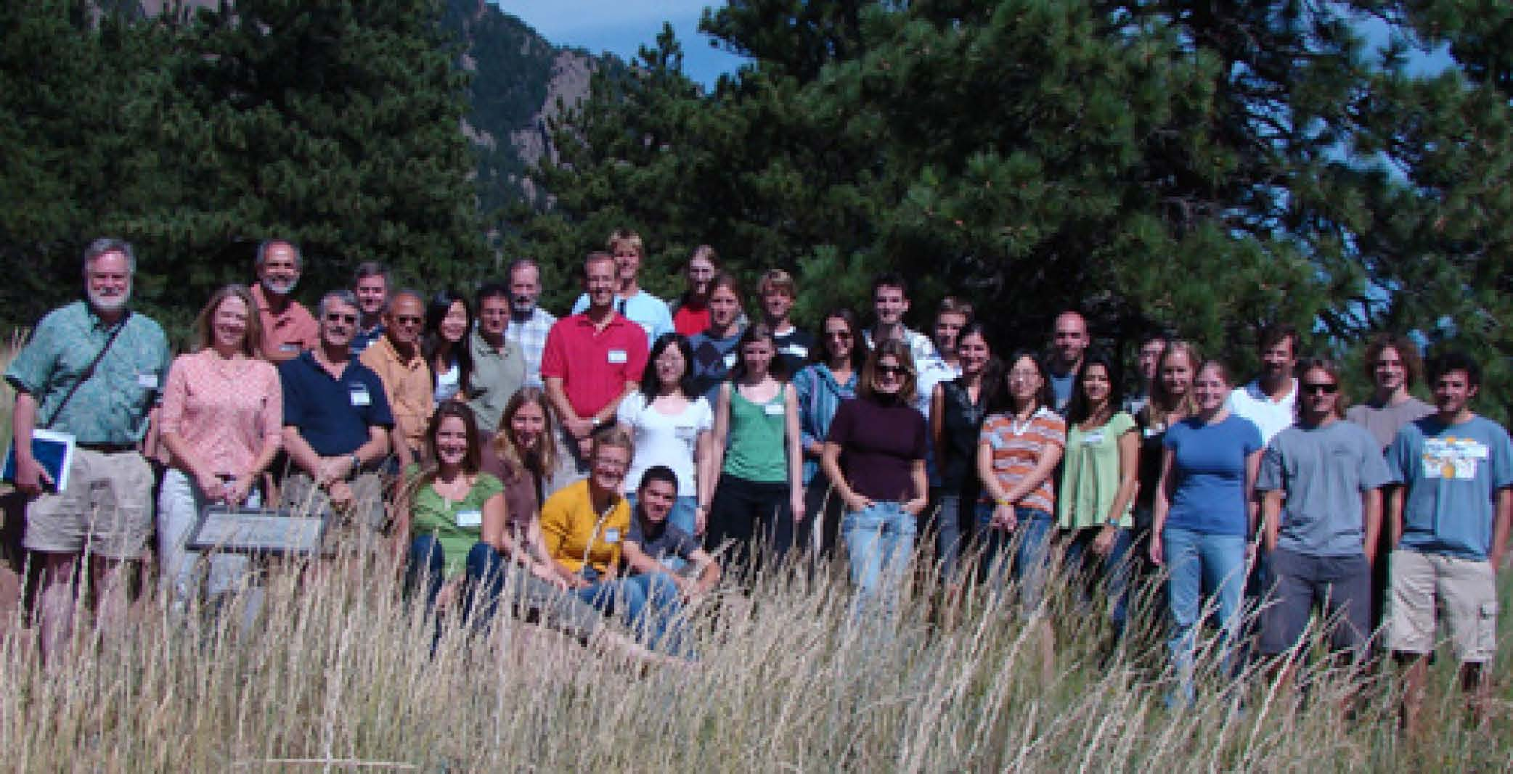
National Center for Atmospheric Research
Advanced Study Program
Colloquium on Marine Ecosystems and Climate
Boulder Colorado
August 2009

Slide 6
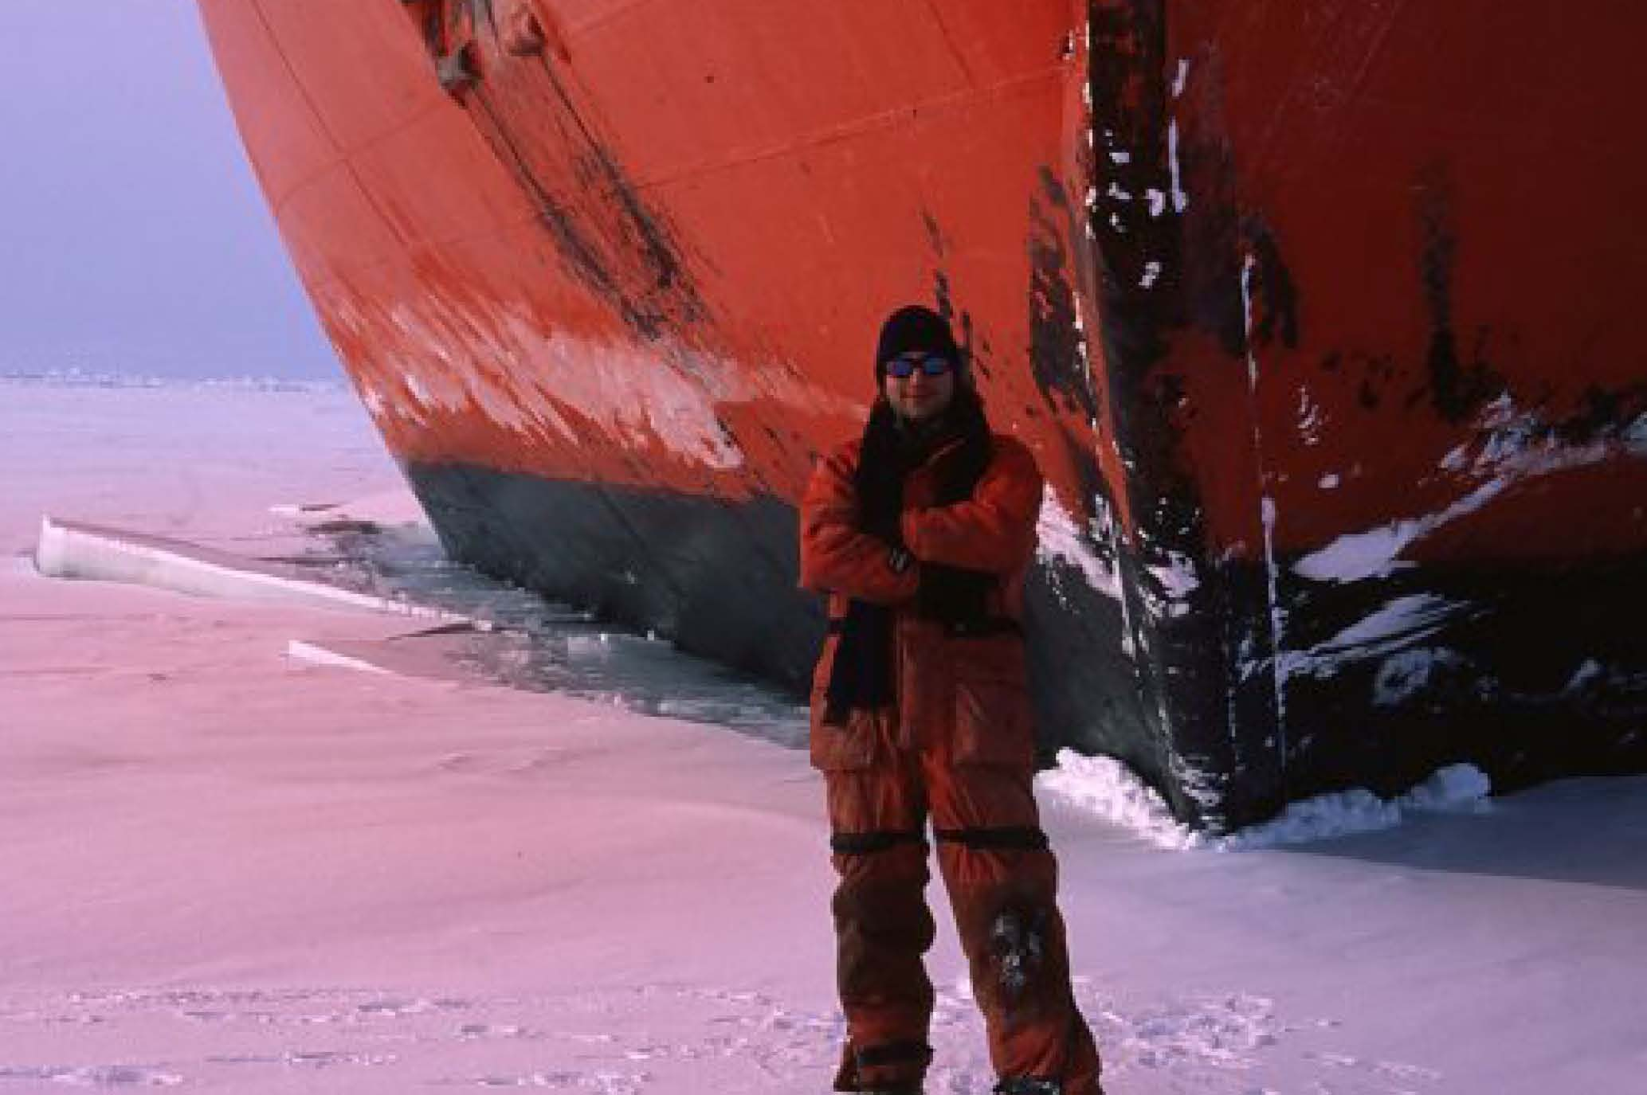
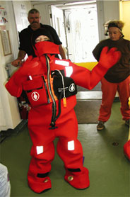
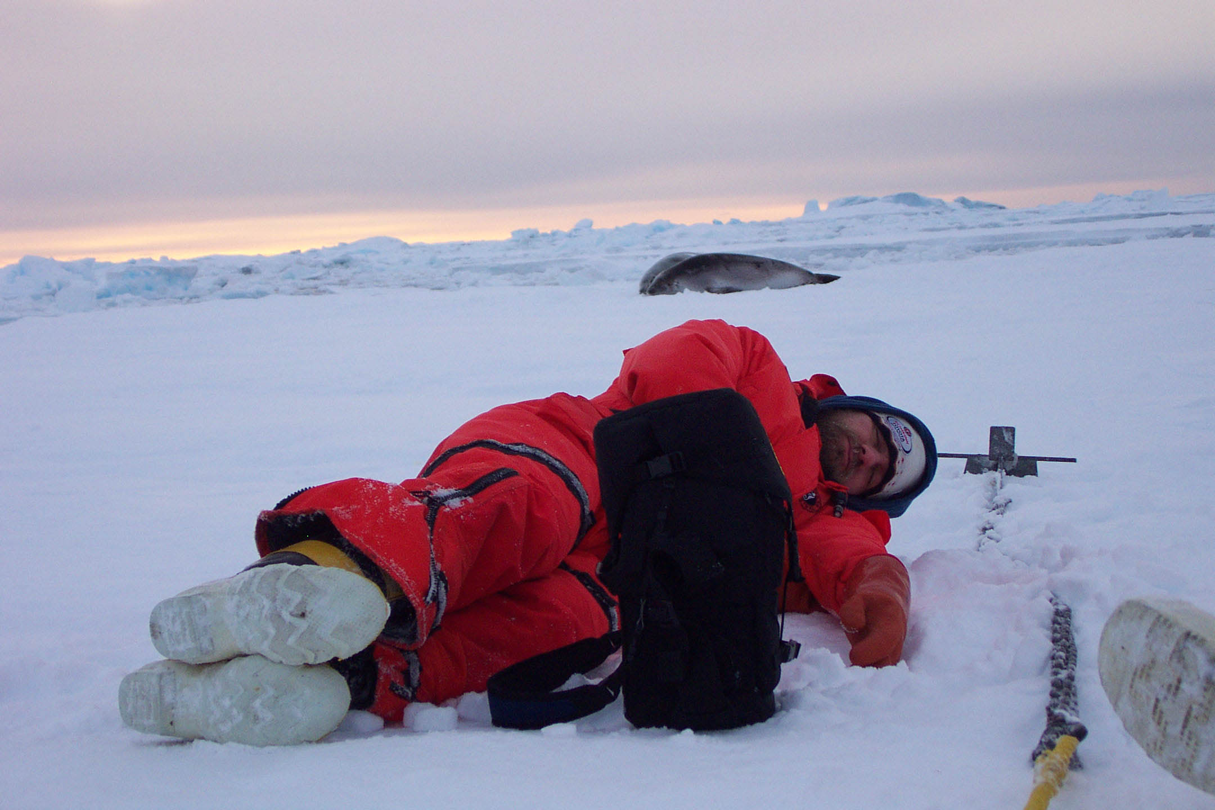
Along the way:
The Trajectories of Three Young Investigators

Slide 7
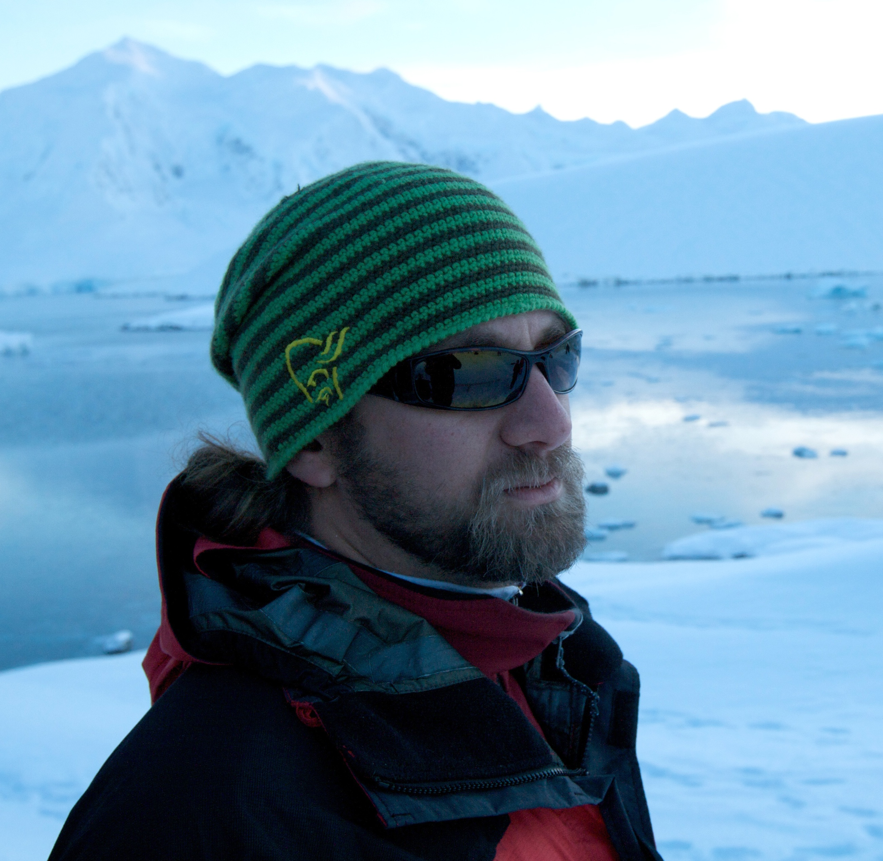
Ari Friedlaender
Biological Oceanographer / Zooplankton Ecologist
Research Scientist
Division of Marine Science and Conservation
Duke University Marine Laboratory
Ph.D. University Program in Ecology, 2006
Duke University Marine Lab, Beaufort, NC
Master’s of Science in Marine Biology, 2000
University of North Carolina at Wilmington, Wilmington, NC
Bachelor’s of Arts, 1996 (Biology High Honors)
Anthropology minor
Bates College, Lewiston, ME

Slide 8
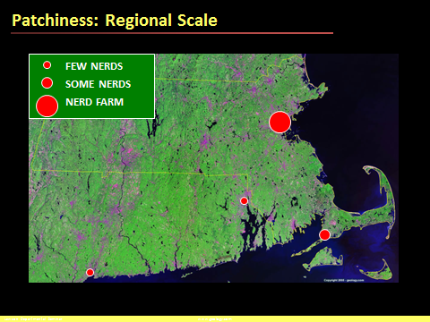
“One of the most inherent and overlooked features of any environment is spatial heterogeneity, or patchiness
Environmental processes create non-random distributions of feature and organisms And these must be accounted for or quantified to be able to gain true ecological inference.”

Slide 9
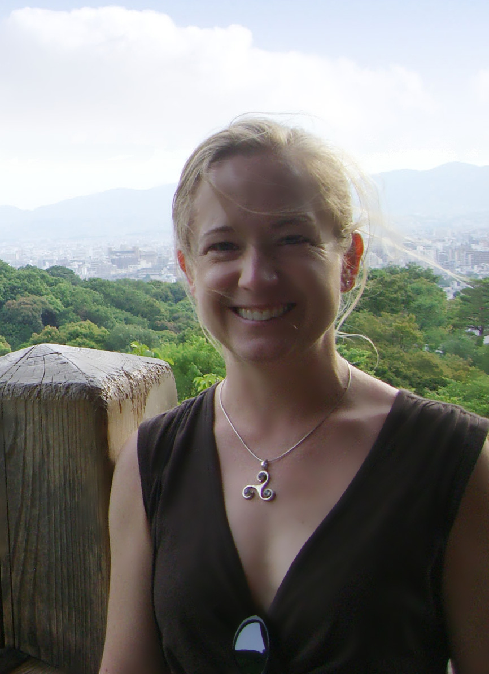
Julie E. Keister
Biological Oceanographer / Zooplankton Ecologist
Assistant Professor
School of Oceanography
University of Washington
Studies of the physical and biological processes that affect abundances and distributions of zooplankton in coastal ecosystems using a combination of field collections, satellite data, and laboratory experiments.
Ph.D. / Biological Oceanography, April 2008
College of Oceanic and Atmospheric Sciences, Oregon State University
M.S. / Marine-Estuarine-Environmental-Sciences, December 1996
Chesapeake Biological Laboratory, University of Maryland System
B.S. / Biology, May 1989
University of North Carolina at Chapel Hill

Slide 10
“My CV doesn't describe my GLOBEC trajectory, which was:
hired at OSU by Bill in 1998 to run the zooplankton portion of the NEP LTOP (my first job as an oceanographer), started a PhD program at OSU in 2003 advised by Tim Cowles to work on zooplankton in the NEP Mesoscale studies, graduated in 2008 and started an Assistant Professor position at UW where I continue to work on GLOBEC Pan-Regional studies lead by Manu Di Lorenzo.”

Slide 11
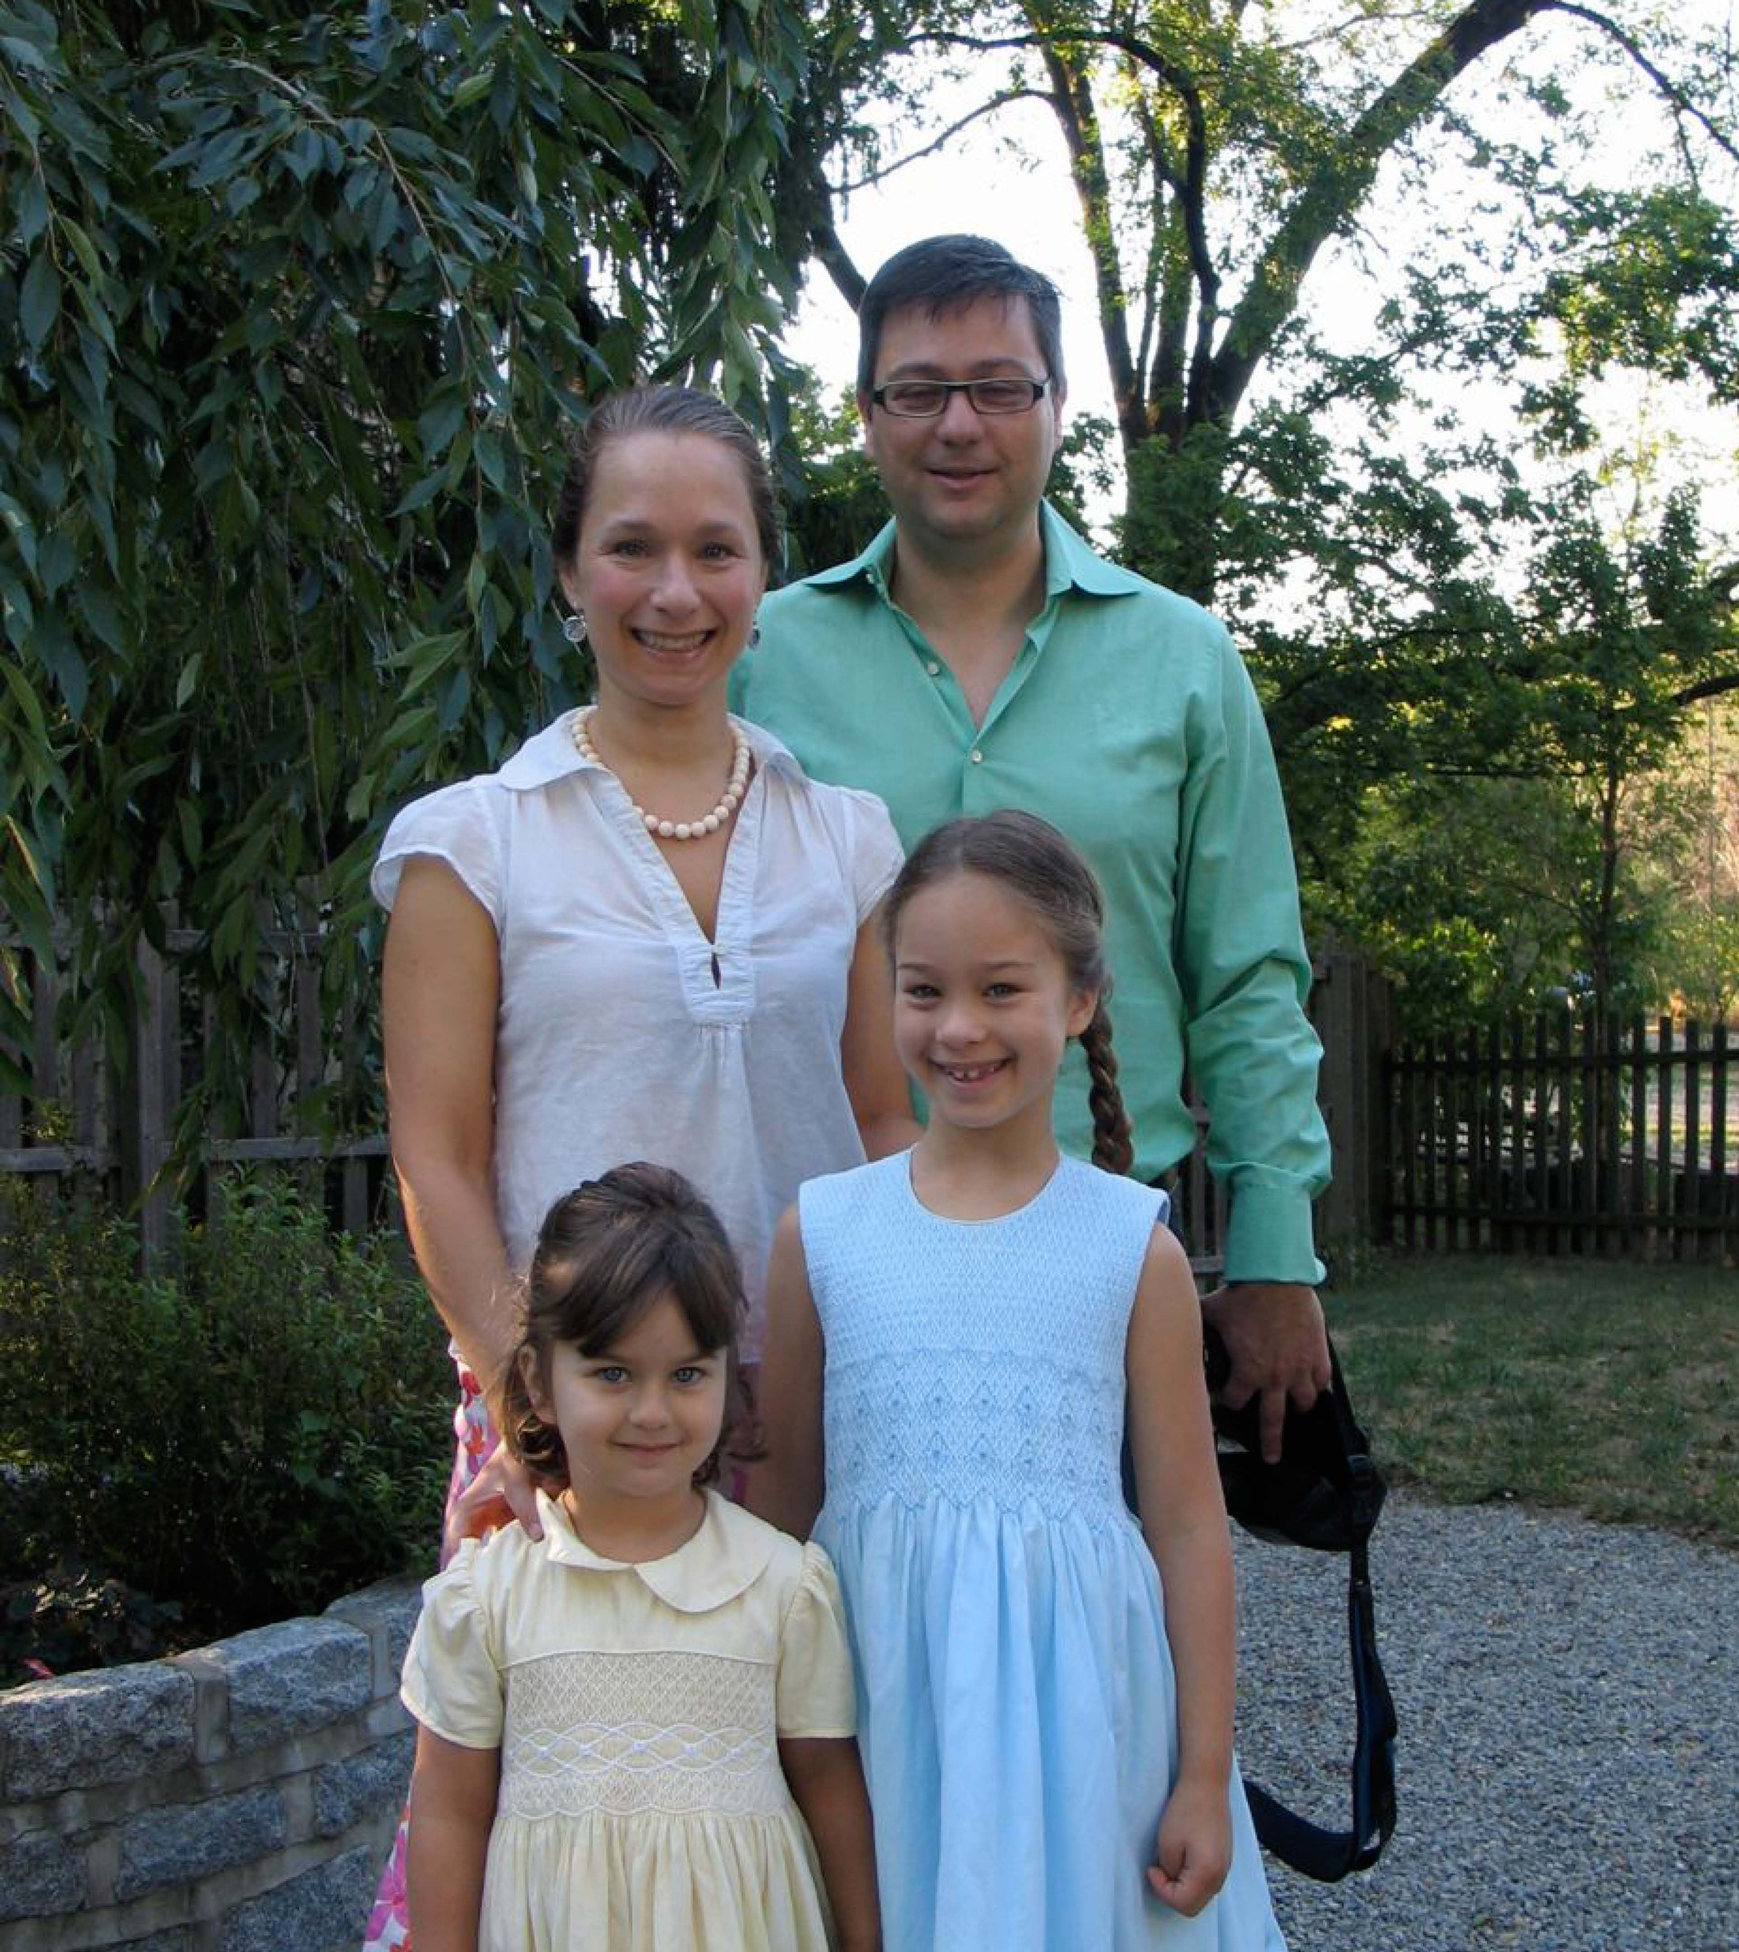
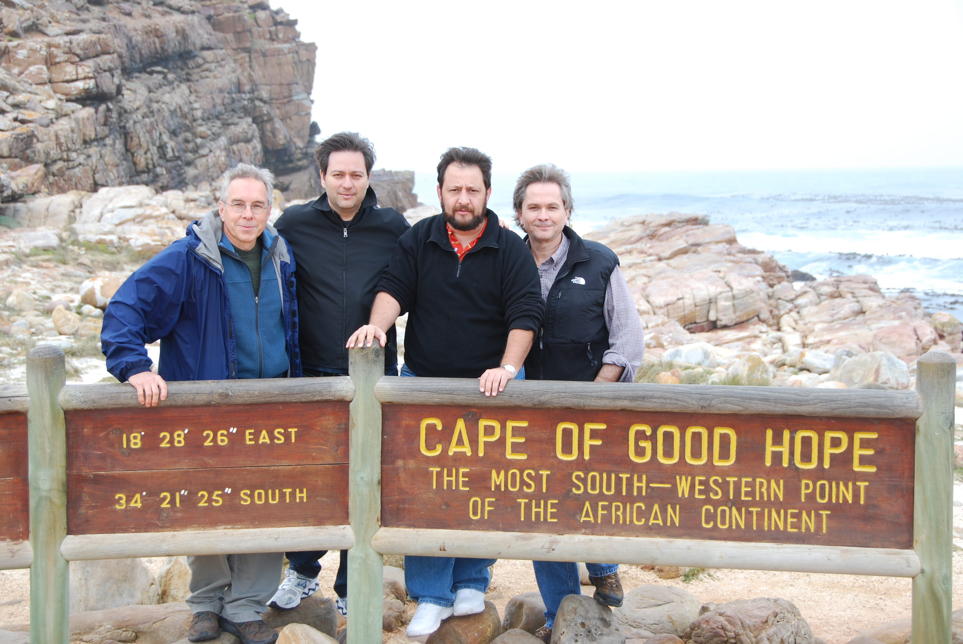
Enrique Curchitser
Physical Oceanographer / Earth System Scientist
Associate Research Professor
Institute of Marine and Coastal Sciences
Rutgers University
Research Interests: Modeling the state of everything
1999 Ph.D. in Oceanography, Rutgers University.
1993 M.S. in Mechanical and Aerospace Engineering, Rutgers University.
1988 B.S. with honors, in Mechanical and Aerospace Engineering, Rutgers University.

Slide 12
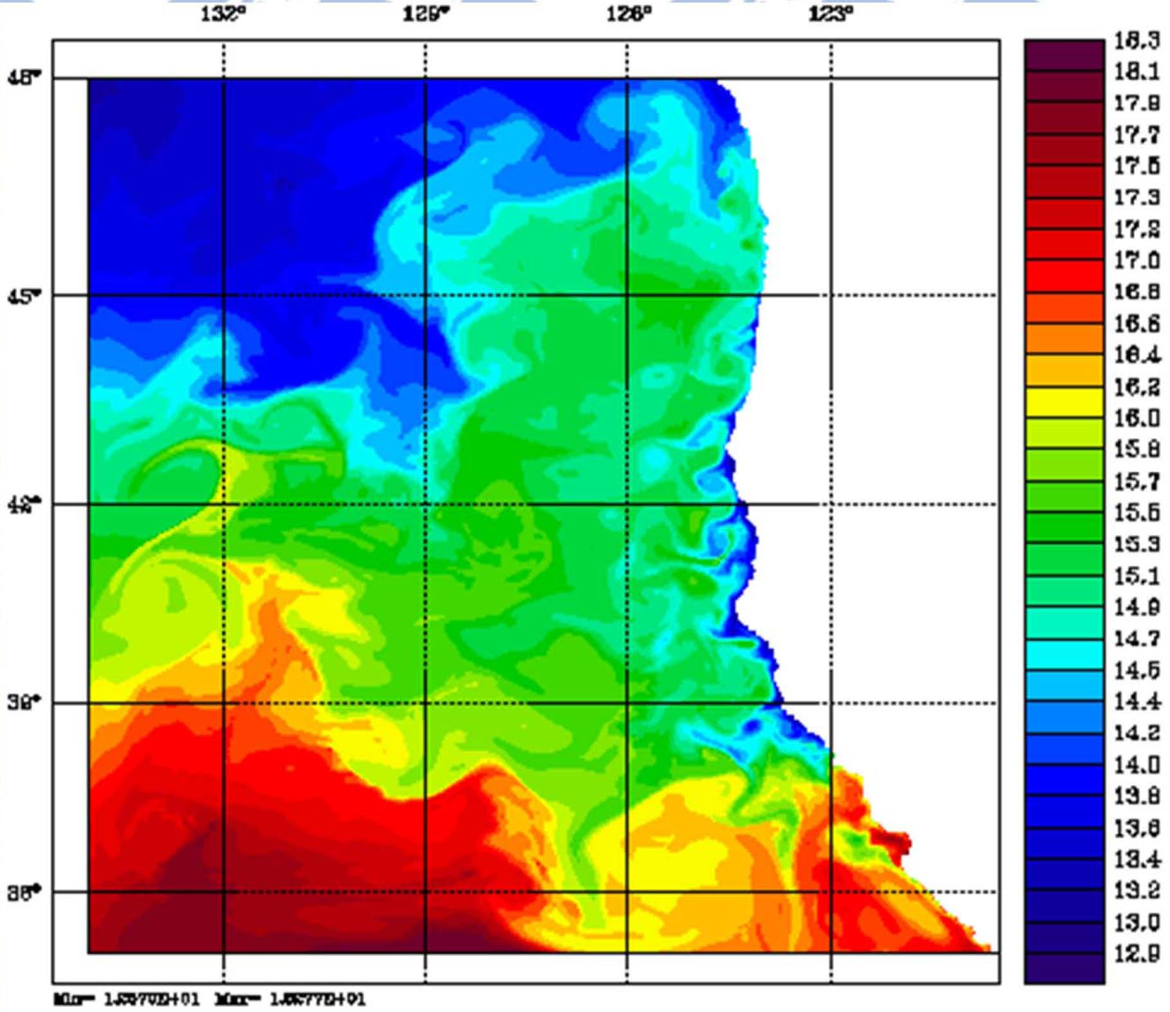
“Ultimately, the most rewarding aspect of the path I started with GLOBEC is the network of scientists, which are now my collaborators. From climate modelers to fisheries scientists, for me GLOBEC was the
springboard to a new way of thinking about the ocean and its ecosystems including humans.”

Slide 13
We were all young once …..
Can you identify the following “baby” pictures?

Slide 14
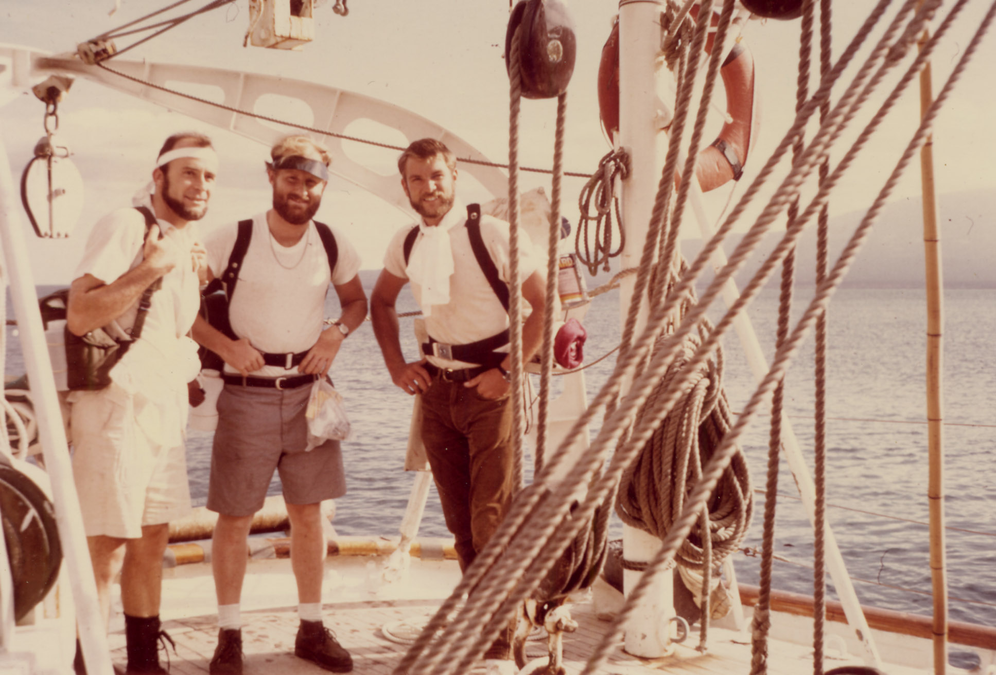
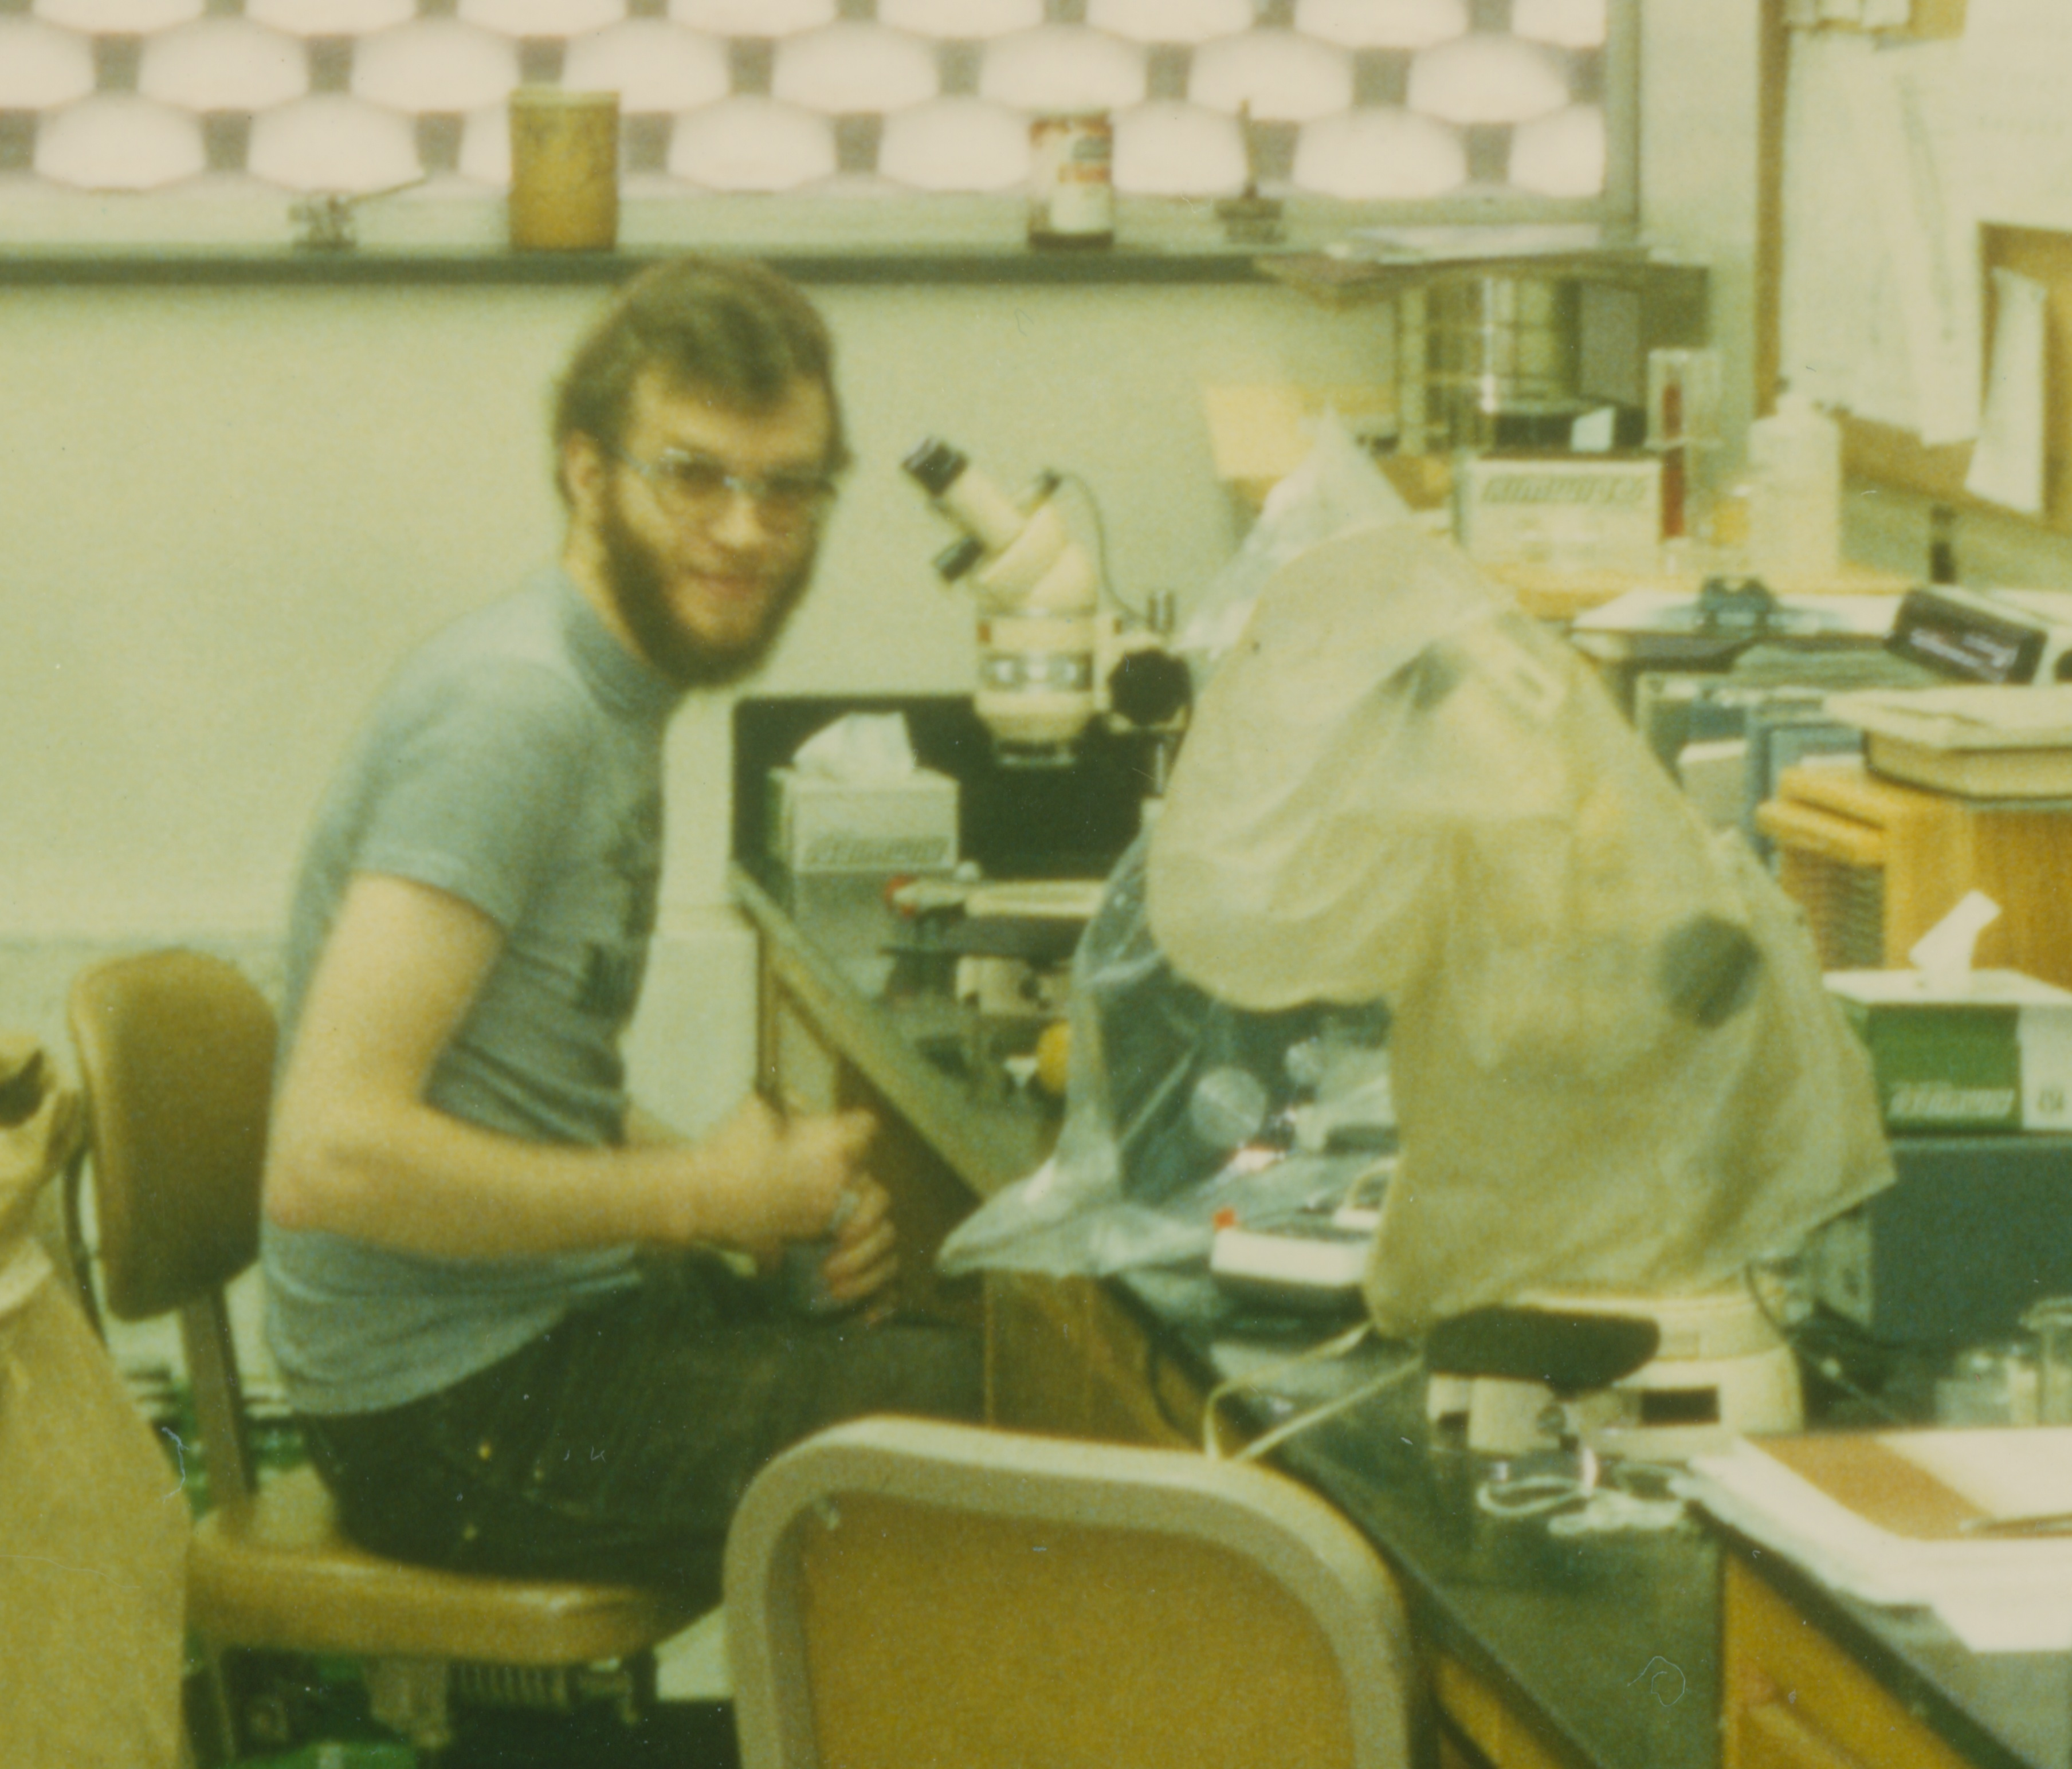
Aboard the R/V TeVega
In the Galapogas
August 1968
In Charlie Miller’s lab at OSU, circa 1984

Slide 15
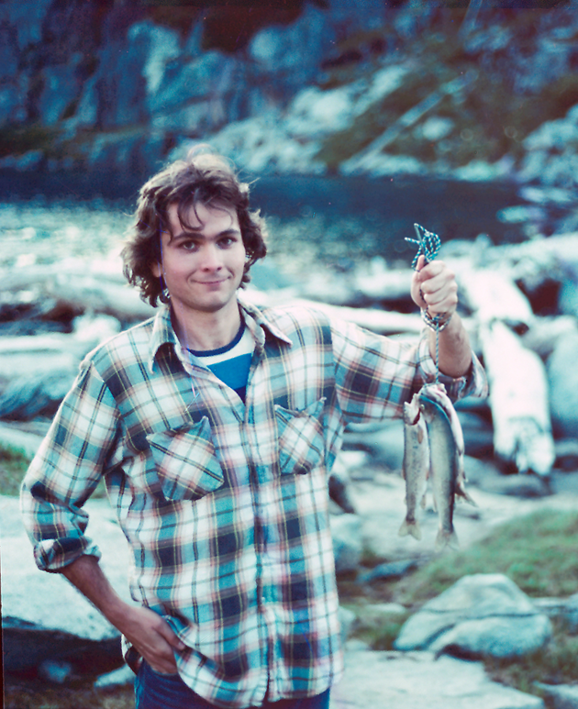
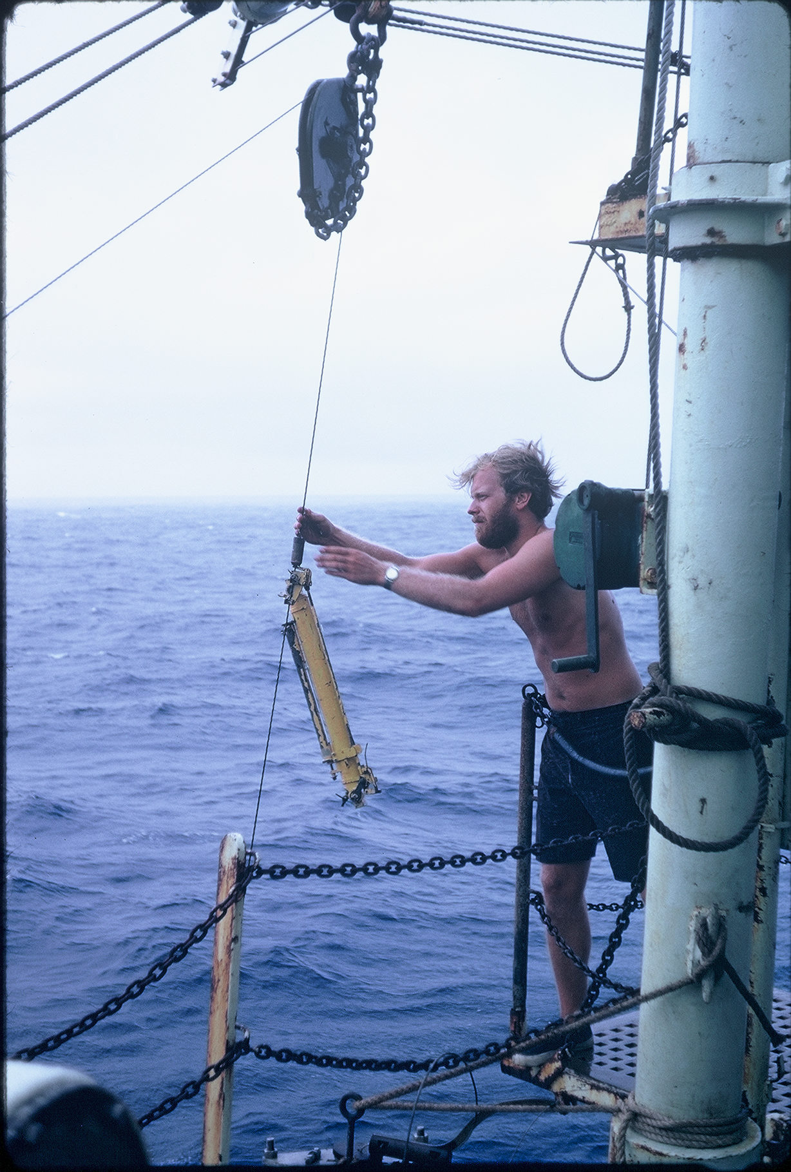
Aboard the R/V Atlantis II
In the Equatorial Atlantic
Summer, 1971
In the Cascade Mountains, 1984

Slide 16
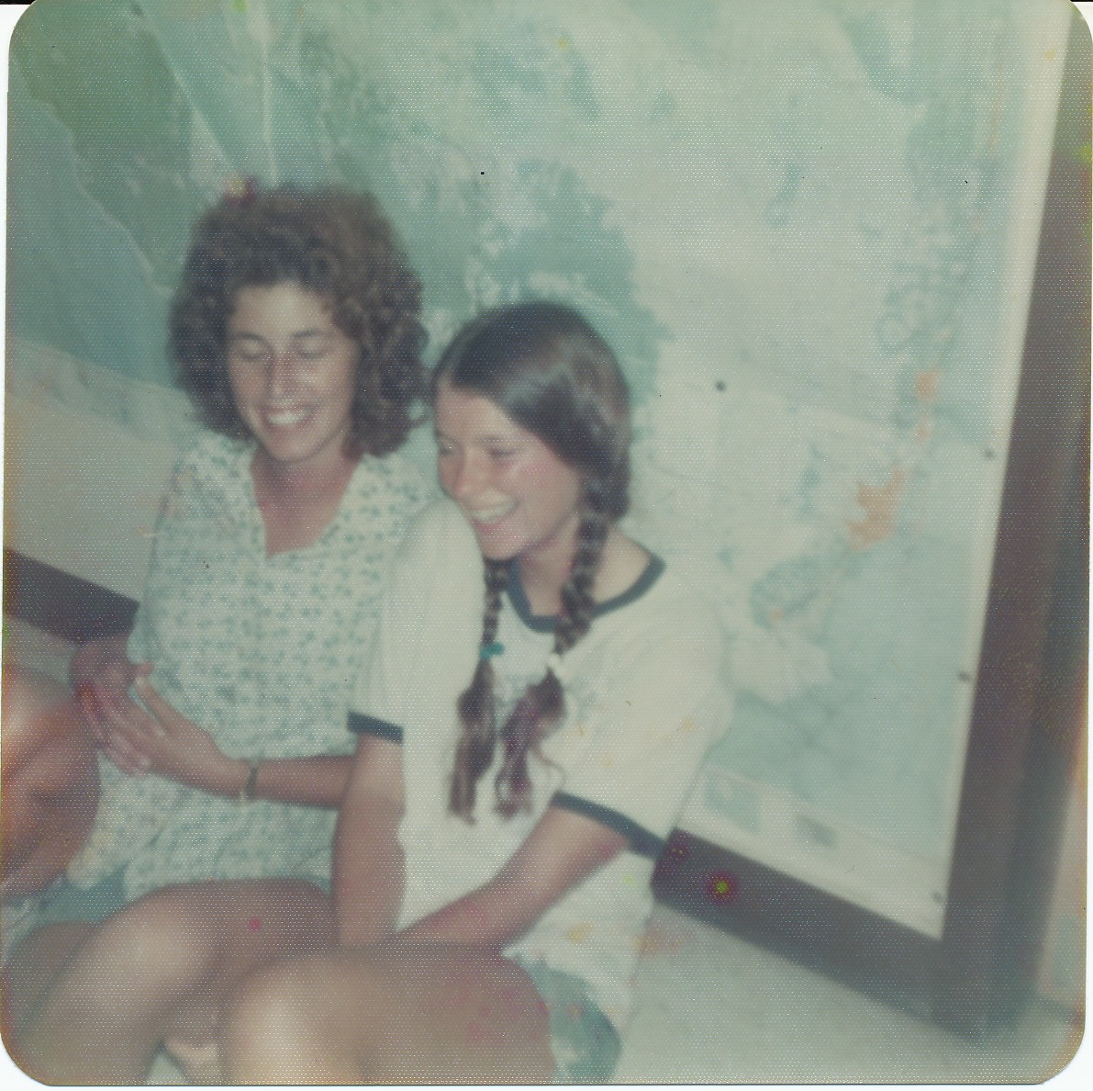
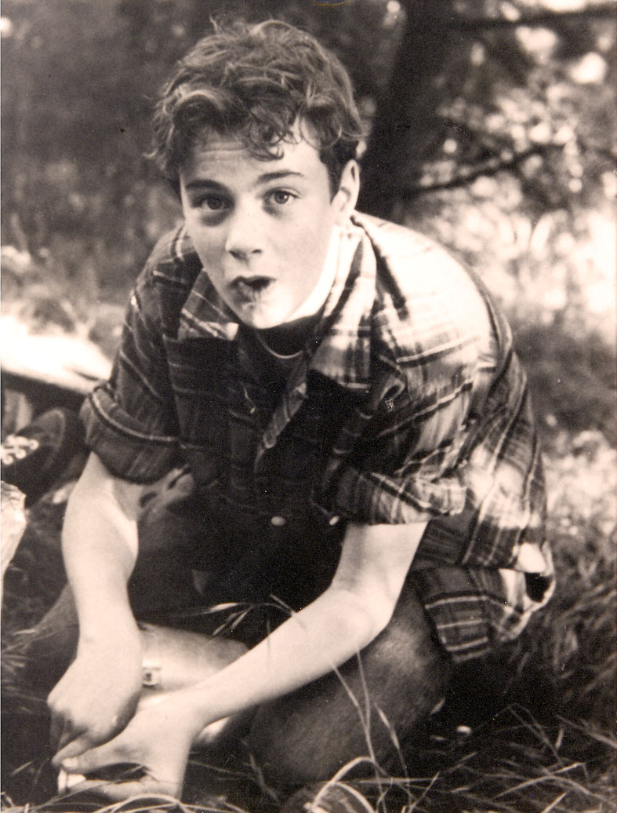
A marine tech working at Skidaway for Larry Atkinson in the late 1970’s
A young ? in 1954 or ‘55

Slide 17
juvenile hard clams on Cape Henlopen, DE summer 1988

Slide 18
