Slide 1
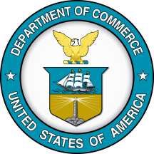
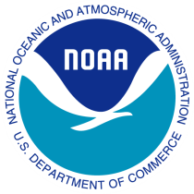
U.S. GLOBEC THE VIEW FROM NOAA
The Honorable Dr. Larry Robinson
Assistant Secretary of Commerce for Conservation & Management National Oceanic & Atmospheric Administration | NOAA
Notes:
Thank you for the invitation to provide a perspective from NOAA on our longstanding investment in the U.S. GLOBEC program. I am pleased to be here today to celebrate the important insights and tools that resulted from U.S. GLOBEC.

Slide 2
Outline
Overview of NOAA mission areas and intersections with U.S. GLOBEC research themes
Influence of U.S. GLOBEC program
Importance of partnerships
Thoughts on future ocean science programs
Notes:
I would like to begin with a short outline of my remarks.
I will provide some perspective on important mission areas of NOAA, and where they intersect U.S. GLOBEC research themes in the context of
Climate variability and its impacts,
Regional ecosystem focus, and
Developing the capacity for predictive modeling and ecological forecasting.
I will then touch on some areas where U.S. GLOBEC has influenced NOAA programs, and some wider influences of the program.
I will give a few remarks on our valuable partnerships and their importance
And I will finish up with some thoughts about future ocean science programs

Slide 3
NOAA Mission
Science, Service, and Stewardship.
To understand and predict changes in climate, weather, oceans, and coasts,
To share that knowledge and information with others, and
To conserve and manage coastal and marine ecosystems and resources.
Next Generation Strategic Plan
Notes:
NOAA’s mission is to understand and predict changes in the Earth's environment, and to conserve and manage our coastal and marine resources.
NOAA’s mission is focused on science, service, and stewardship. To implement our mission to understand and predict changes in the Earth's environment, to share that knowledge with others, and to conserve and manage our coastal and marine resources, NOAA released our “Next Generation Strategic Plan” in December 2010.
U.S. GLOBEC has been an important part of this mission through its observations, field studies and modeling and the development of predictive tools.

Slide 4
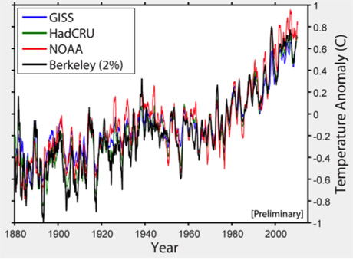
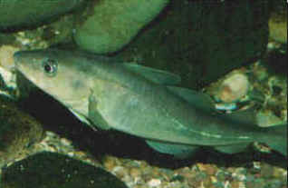
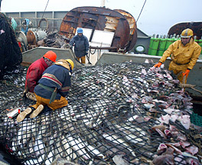
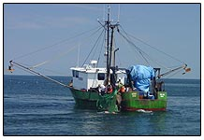
Climate Impacts
Understanding the interactions of climate with marine resources is a challenging scientific field and vital to our national interests.
Notes:
Understanding the interactions of climate with marine resources is a challenging scientific field and vital to our national interests.
Important processes are occurring on regional scales, with larger global-scale influences.
The need for resource management to account for climate forcing is clear:
Changes in physical forcing on a regional basis may cause profound geographic shifts in species distributions.
Changes in ocean chemistry and physiological processes can drastically change the structure and functioning of the marine ecosystem.
It is essential to
Predict the probable consequences of global climate variability and change on marine ecosystems and their valuable fishery resources and
Deliver the knowledge and predictive tools to fisheries managers, enabling the incorporation of climate impacts into the management of living marine resources

Slide 5
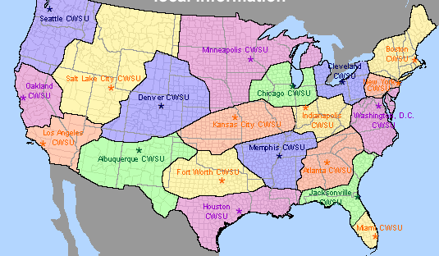
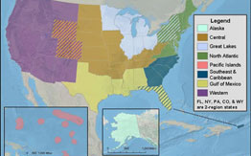
NOAA’s Regional Approach
NOAA Large Marine Ecosystems
NOAA Fisheries Service Field Structure
NOAA Weather Service Regional Offices
NOAA Regional Collaboration Teams
Notes:
NOAA has a focus on regional ecosystems:
ecologically through the Large Marine Ecosystem concept, and
organizationally through the NOAA regional teams, the NWS regional forecast offices, and the regional science centers within NMFS.

Slide 6
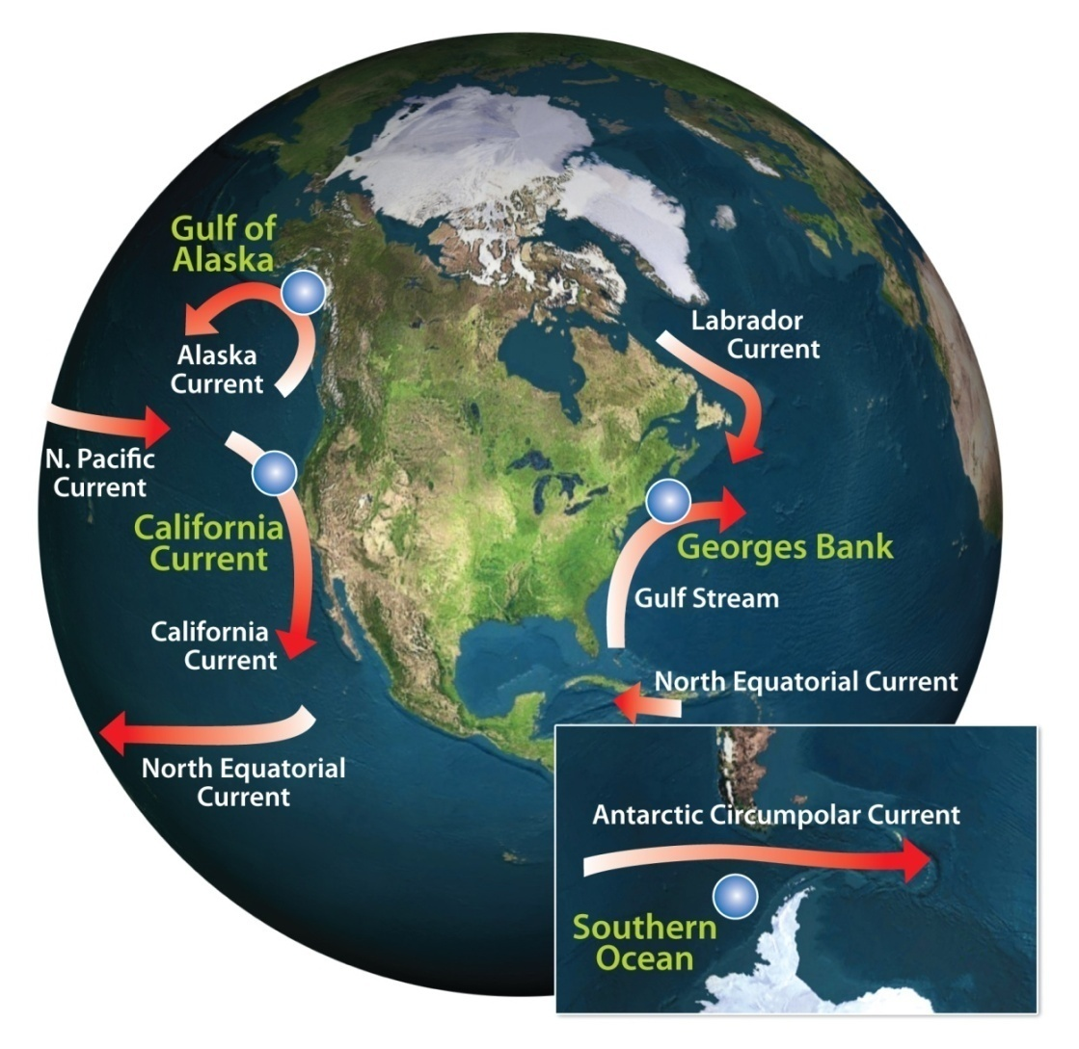
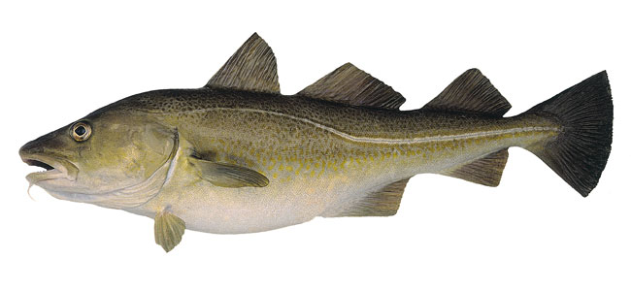
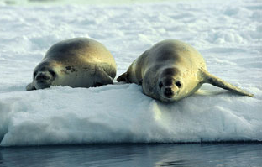
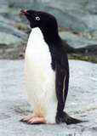
Regional ecosystems: U.S. GLOBEC
Northeast Pacific
Northwest Atlantic
Southern Ocean
Notes:
U.S. GLOBEC also took a regional approach, and these regions are in areas where climate variability can impact resources in important ways.
In the Northwest Atlantic, Georges Bank was selected for study, with target fishery species of cod and haddock Georges Bank is at a bio-geographic boundary between temperate and boreal waters, influenced by the Gulf Stream from the south and the Labrador current from the north.
In the Southern Ocean, studies centered on the Antarctic Peninsula with target species of Adelie penguin and crabeater seals. Little was known about population dynamics in SO winter and in spite of the significant challenges, U.S. GLOBEC chose to focus on the winter season for their fieldwork.
In the Northeast Pacific, the California Current and the Gulf of Alaska have important fisheries on Coho, Chinook, and Pink salmon. Prior to the GLOBEC program, several studies existed on the impacts of climate to the freshwater portion of salmon’s life history usually linked to freshwater delivery. Less was known on sea-going juveniles and their life in the ocean.

Slide 7
Northeast Pacific Salmon and PDO
Prior to GLOBEC, correlations identified between salmon returns and large-scale features such as the Pacific Decadal Oscillation
GLOBEC sought to understand mechanisms behind correlations
Notes:
Strong connections exist between upwelling systems and basin-wide phenomena such as the Pacific Decadal Oscillation (PDO). Here is an example of the spring Chinook salmon returns compared with the PDO. These relationships were identified prior to GLOBEC studies, but GLOBEC sought to go beyond correlations and get to the mechanisms behind the relationships.

Slide 8
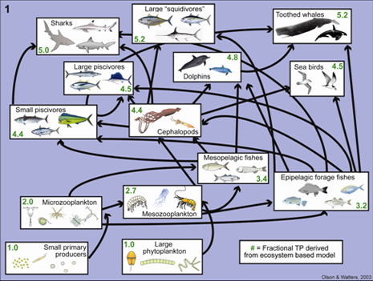
EBM and Predictive Modeling
Ecosystem-based management demands an understanding of ecosystem interactions and the ability to make complex multidisciplinary science actionable for use by managers.
Modeling can provide an integrative framework and lead to forecasts to be used in management
Notes:
The GLOBEC interdisciplinary approach is vital to EBM, which demands an understanding of ecosystem interactions and the ability to utilize this understanding in an ecosystem context.
GLOBEC science was done on a regional ecosystem scale before there was any nationwide recognition of or mandate for EBM.
Coupled bio-physical modeling developed through GLOBEC provides insight into ecosystem changes not possible from single-species observations and experiments.
Modeling and ecological forecasting of complex ecosystem interactions are now within our grasp and absolutely necessary to make complex multidisciplinary science actionable for use by managers.

Slide 9
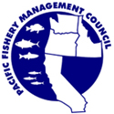
Applications of GLOBEC results to NOAA priorities: Fishery Management
Incorporation into deliberations within the regional FMCs on EBM
Especially New England , North Pacific and Pacific
Predictions of salmon returns based on environmental indices
Notes:
There is no doubt that the science results have led to huge increases in understanding of marine ecosystems.
These science advances will be the subjects of many of the talks at this symposium over the coming days.
I wanted to highlight a few examples of how some of the results can be used in areas important to NOAA. Some of these will also be covered later in the symposium in more detail.
Fishery management in the US is implemented through regional Fishery Management Councils. Each of these regional bodies is considering how they can incorporate EBM into their management plans through ecosystem fishery management plans. Work from U.S. GLOBEC has provided a strong basis for NMFS to be able to advise the FMCs on their Ecosystem Fishery Management Plans. This is especially applicable in the regions where U.S GLOBEC studies occurred.
The Ecosystem Considerations chapter provided by NMFS to the North Pacific Fishery Management Council is an example of ecosystem information being provided on an annual basis to a FMC. Regional ecosystem research results from programs such as GLOBEC can be incorporated into these summaries and enter into the FMC process.
Another way that research results can influence management is through development of targeted forecasting tools. GLOBEC also played a part in developing annual indices of salmon returns. This uses a variety of physical and biological variables that relate to the success of salmon in their first year at sea, and the potential for good returns to their spawning rivers. It is presented in a simple table fashion, and updated twice a year.
This will be discussed in more detail in a later talk (Peterson and McGillicuddy, this afternoon)

Slide 10
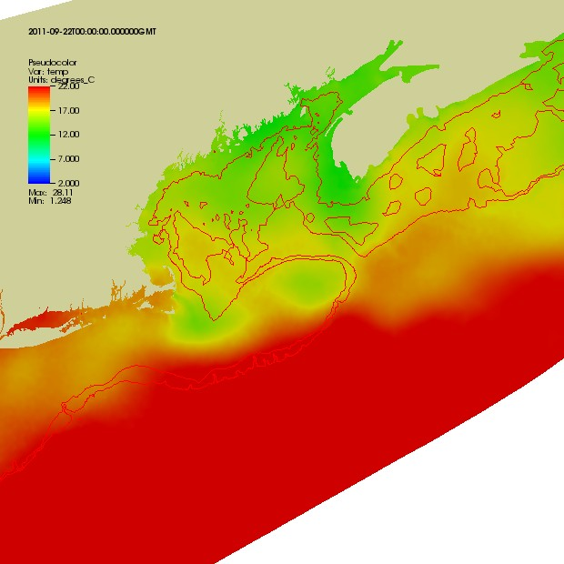
Applications of GLOBEC results to NOAA priorities: Ocean Observations
Long-term GLOBEC observations influenced locations of IOOS regional nodes
GLOBEC models are available operationally through IOOS regional entities
E.g., Northeast Coastal Ocean Forecast System (NECOFS)
U.S. GLOBEC data management structure utilized by IOOS and other ocean science programs
IOOS Regional Associations
NECOFS Model Results
Notes:
Another area of importance to NOAA is the Integrated Ocean Observing Systems. Several IOOS nodes were influenced by the long-term datasets collected by GLOBEC
In the Gulf of Maine, the California Current, and the Gulf of Alaska, U.S. GLOBEC has influenced the location of observations as well as the use of observations through models.
Models developed through GLOBEC laid the foundation for many of the modeling frameworks currently in use through IOOS and other applications.
As an example, here is output from the Northeast Coastal Ocean Forecast system that is currently served through the Northeast Regional Association of Coastal and Ocean Observatories.
The modeling framework used is the Finite Volume Coastal Ocean Model, which was developed through GLOBEC investments.
Finally, GLOBEC data management was a model for other large data management efforts used in IOOS and across the oceanographic community. The U.S. GLOBEC Data Management Office was a precursor to the Biological and Chemical Oceanography Data Management Office centered at Woods Hole Oceanographic Institution.

Slide 11
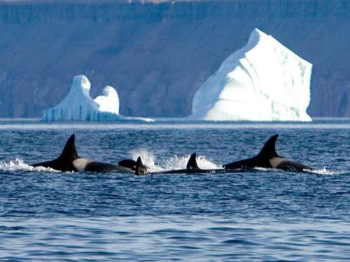
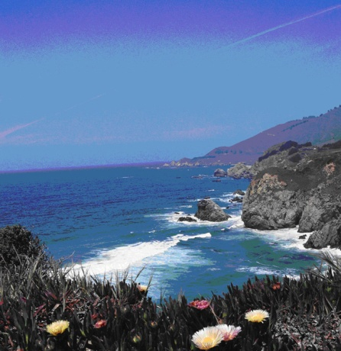
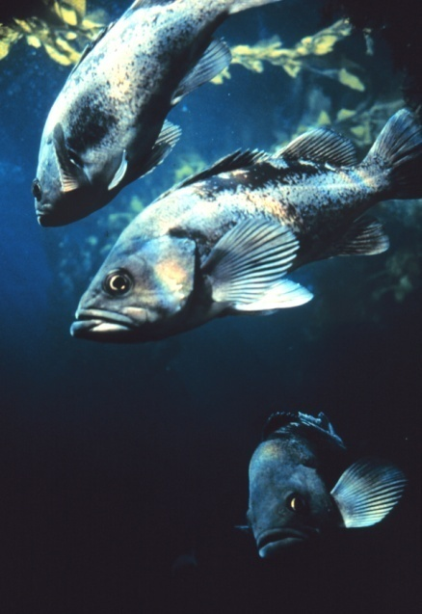
Influence of U.S. GLOBEC on NOAA Research Programs
Fisheries and the Environment (FATE)
Climate Regimes and Ecosystem Productivity
Regional Ecosystem Prediction Program
Coastal and Ocean Climate Applications
Ecological Forecasting
Notes:
NOAA has built on U.S. GLOBEC studies to create other programs within the agency that use GLOBEC-like approaches:
The NMFS Fisheries and the Environment program seeks to
develop ecosystem indicators
incorporate ecosystem indicators in stock assessments, and
Construct the next generation of forecasting models.
Several of the research accomplishments of U.S. GLOBEC have transitioned through the FATE program to become NOAA products, such as the Ecosystem Chapter for the North Pacific Management Council, and the salmon return indices mentioned previously.
The NMFS Climate Regimes and Ecosystem Productivity program in the Bering Sea seeks to understand climate patterns and their impact on ecosystem dynamics.
it uses some of the same modeling platforms that were developed through U.S. GLOBEC, and takes the same approach to integrating observations, process studies, and modeling.
The NOS Regional Ecosystem Prediction Program (REPP) provides coastal resource managers with predictive tools and capabilities to improve their ability to protect, conserve, and restore the Nation’s ocean, coastal, and Great Lakes ecosystems. The program works at the regional ecosystem scale to address problems identified by regional managers as priorities. The regional ecosystem scale and the integrative approach to observations and modeling that were hallmarks of U.S. GLOBEC are key to the REPP’s focus area.
The OAR Climate Program Office has a program in Coastal and Ocean Climate Applications. It seeks to improve understanding of the vulnerabilities of coastal communities and coastal and marine ecosystems in a changing climate; and Support the incorporation of climate information, including information on climate risks, vulnerabilities, and uncertainty, into decision-making processes. Programs such as these can help extend the uses of the results of GLOBEC research.
A cross-NOAA working group has been developing approaches to use ecosystem understanding and modeling to develop a capacity to forecast ecosystem conditions. Some of the physical models developed through U.S. GLOBEC are being incorporated into operational use in NOAA’s ocean modeling efforts, and can support future ecological forecasts.

Slide 12
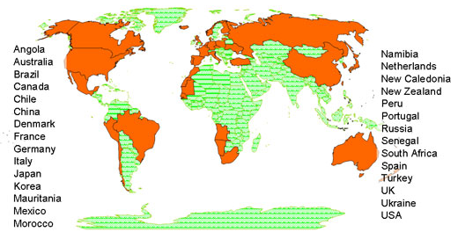
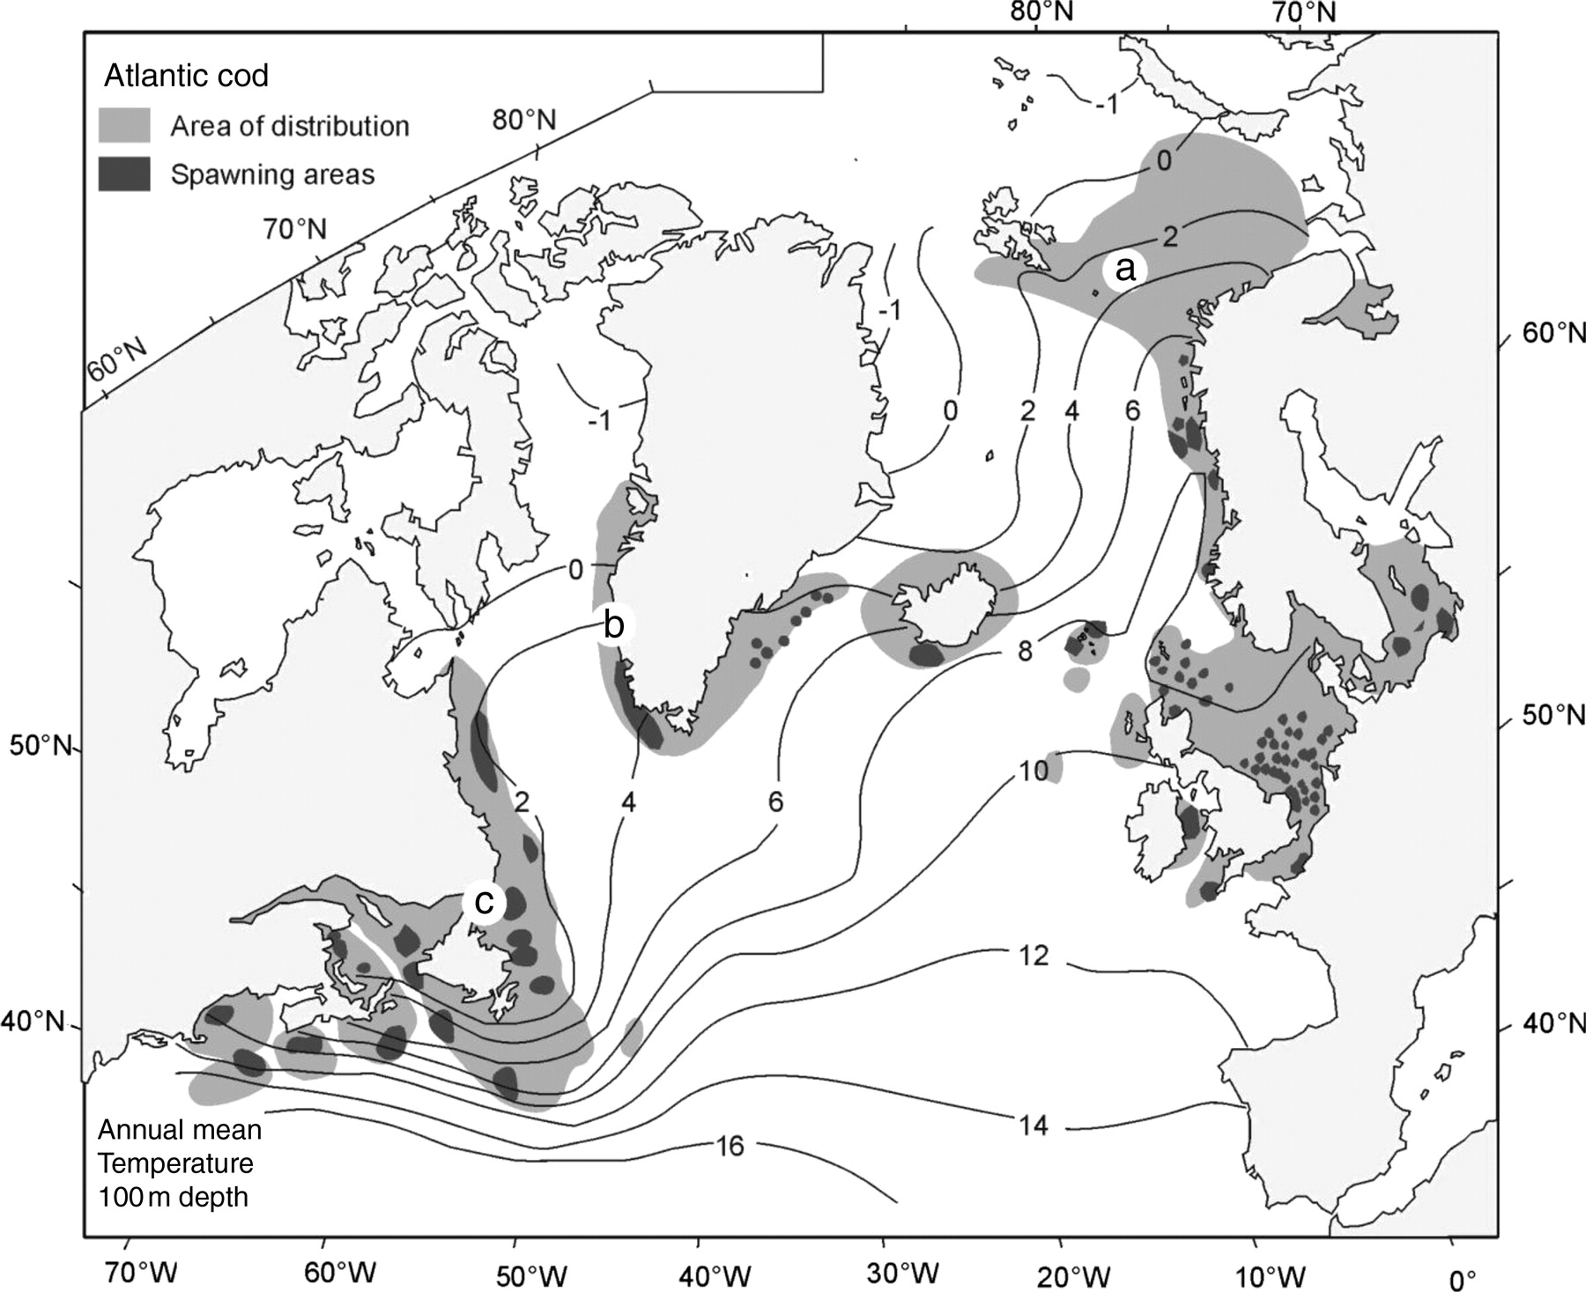
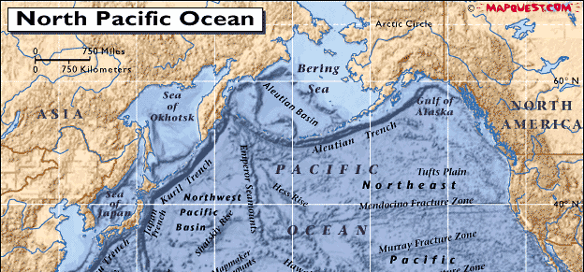
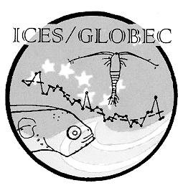
Influence of U.S. GLOBEC on International Programs
International GLOBEC
ICES Cod and Climate Change
PICES Climate Change and Carrying Capacity
International GLOBEC countries
Locations of PICES Climate Change and Carrying Capacity regional programs.
Cross-Atlantic distribution of Cod
Notes:
In addition to impacts within NOAA, U.S. GLOBEC was important to international efforts.
It was in existence before the International GLOBEC program was initiated, and provided an example for international partners to develop their own national GLOBEC programs.
The International Council for the Exploration of the Seas (ICES) Cod and Climate Change program was an International GLOBEC program heavily influenced by U.S. GLOBEC Northwest Atlantic studies. US scientists supported under GLOBEC were able to compile their findings with international colleagues to gain a cross-Atlantic basin understanding of these important fish stocks.
The Pacific counterpart to ICES, PICES, has an active international focus on climate and its influence on fish stocks through its Climate Change and Carrying Capacity theme. US GLOBEC scientists from the Northeast Pacific program were key contributors to several reports, including:
PICES Report #34 in 2008. “Forecasting Climate Impacts on Future Production of Commercially Exploited Fish and Shellfish” and
PICES Report #25 in 2003 on Trophic Models of the Subarctic Pacific Basin Ecosystems.

Slide 13
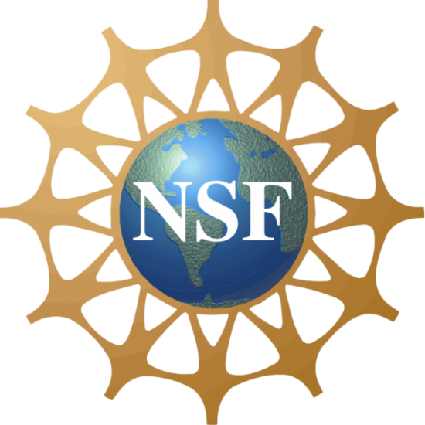
Partnerships
NSF-NOAA
Leveraging dollars and intellectual capacity from different agencies and sectors
One-NOAA
Bringing all of NOAA’s capabilities together to address challenging issues
Notes:
Beth’s prior remarks highlighted some of the partnership aspects of the program
U.S. GLOBEC was able to bring together scientists from different fields and different areas of NOAA as well as two major funding agencies to address these important issues
GLOBEC was truly a "one-NOAA" program as well as a strong NOAA-NSF partnership.
Only by integrating all of NOAA’s capabilities with our external partners can we make progress on complex issues such as the ones GLOBEC addressed.

Slide 14
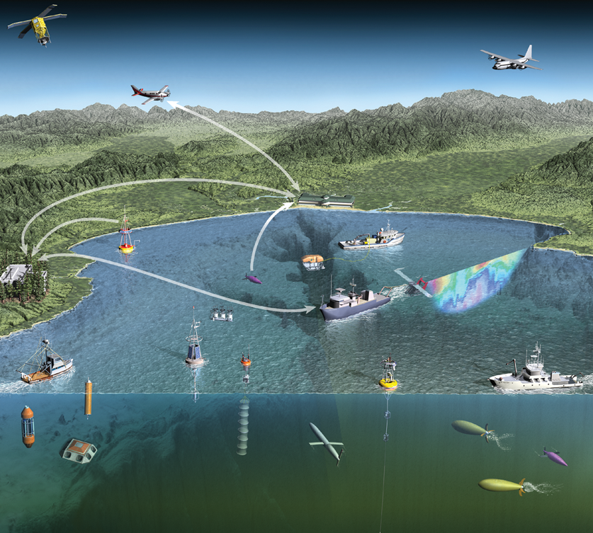
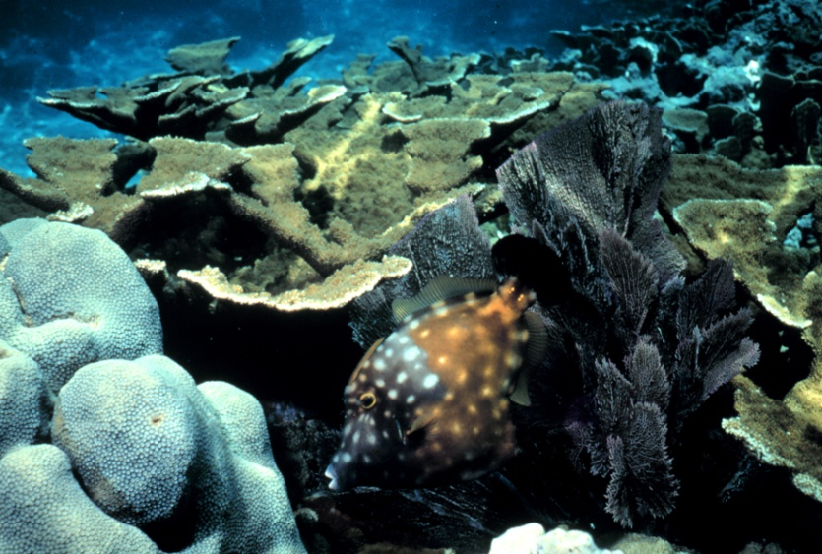
Looking to the Future
NSF-NOAA Partnerships
Ocean Observing
Ocean Exploration
Ocean Acidification
Oceans and Human Health
NRC Committee on “Sustainability Linkages in the Federal Government”
Notes:
NOAA and NSF can build on the productive relationships fostered during U.S. GLOBEC to approach other societal issues in the ocean sciences. Some clear examples are:
The intersection of interests around ocean observing, through the OOI and IOOS programs
Shared interests in ocean exploration, including the support of ocean-going research vessels and platforms
Emerging issues of overwhelming importance, such as ocean acidification and oceans and human health
One effort underway across the Federal government, NGOs and industry is a National Research Council study on “Sustainability Linkages in the Federal Government”, sponsored by the U.S. Environmental Protection Agency, U.S. Geological Survey, U.S. Department of Energy, National Aeronautics and Space Administration, U.S. Department of Agriculture, National Science Foundation, National Oceanic and Atmospheric Administration, BP, Lockheed Martin, and the David and Lucile Packard Foundation.
The premise is that sustainability is a systems problem that cannot be achieved by separately optimizing its pieces. It emphasizes a systems approach to long term sustainability. The study will build upon existing and emerging expertise throughout the scientific and technological communities, describing the nexus where domains intersect but existing institutions and disciplines do not.
From NOAA’s standpoint our science, service and stewardship mission involves protecting life and property, conserving and protecting natural resources, and supporting resilient ecosystems, communities, and economies; so the issues of sustainability of resources are extremely important to us.
As these and other efforts move forward, NOAA always strive to provide better and more effective services to the nation. As mentioned previously, this will require all parts of NOAA and all Federal agencies to work together.

Slide 15
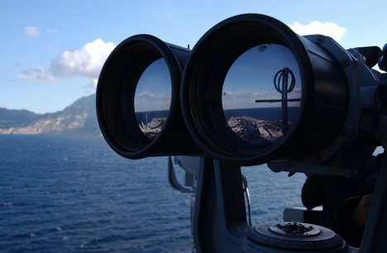
Visionary Ocean Science
What programs of today will be deemed “visionary” in 20 years?
Systems engineering approaches?
Merging of natural and social sciences?
New technologies?
Tight resources should not stop us from supporting visionary, and sometimes risky, approaches because they have the greatest potential to yield large benefits
Notes:
U.S. GLOBEC was advanced for its time in thinking about multidisciplinary research and ecosystem processes in relation to climate. In that respect, it was visionary in thinking about climate impacts on marine ecosystems.
What programs that we invest in today will be deemed visionary in another 20 years?
Will they be systems approaches as in the NRC committee’s charge?
Will they be new integrative approaches that merge natural and social sciences?
Will they be new observing technologies applied to the vast unexplored ocean regions of our planet?
U.S. GLOBEC has managed to persist through many budget cycles, some more favorable than others. One thing is certain – even in light of economic downturns and lean budgets, we cannot and will not stop pushing the boundaries to discover and understand fundamental ocean processes, and utilize this knowledge to better conserve and manage our precious ocean resources.
NOAA is proud to have been an integral part of the U.S. GLOBEC’s success
Congratulations to the program scientists and funding offices on their accomplishments.
I am happy to be able to share in the celebration.

